Slide 1
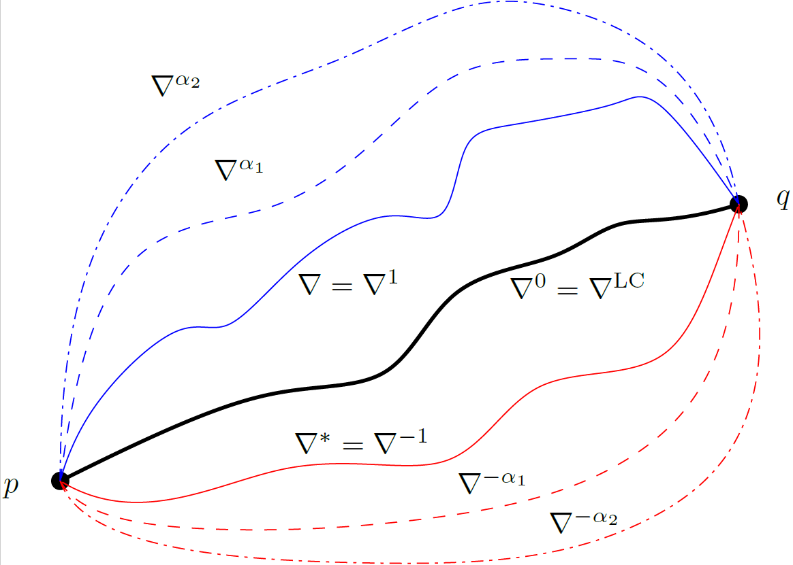
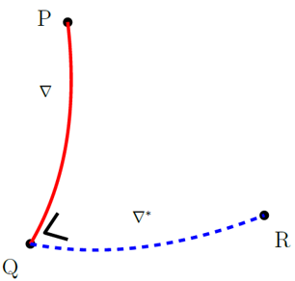

Information geometry for information sciences: - A first intuitive overview -
Frank Nielsen
Sony Computer Science Laboratories, Inc
https://franknielsen.github.io/
An elementary introduction to information geometry
https://arxiv.org/abs/1808.08271

Slide 2
The goal of this talk is to…
Present the main ideas behind the dualistic structures of information geometry
Avoid common misconceptions and pitfalls
Decouple and explain the interplay of geometric structures with distances (dissimilarities/divergences/diversities)
Minimize the use of equations to introduce the key concepts

Slide 3
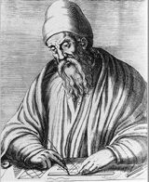
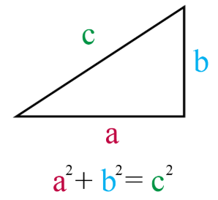
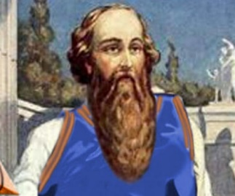
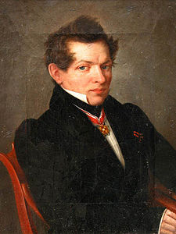
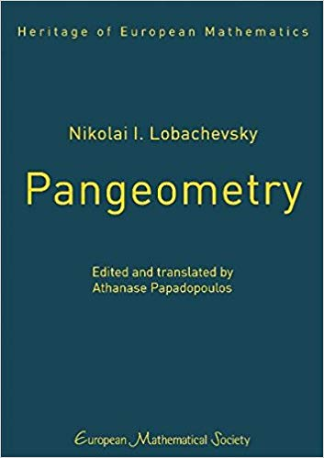
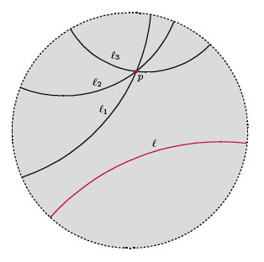
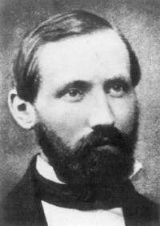
A (too) brief history of geometry
Science for Earth measurements
Pythagoras’s theorem (c570-495 BC)
Euclid’s axiomatization and deduction (c300 BC)
Euclidean geometry
Figures, congruences, construction with compass/rulers
Lobachevskian hyperbolic geometry is consistent (c1800)
Riemannian geometry (c1850): infinitely many consistent differential geometries
Klein’s Erlangen program: classification (action of a group)
Etc.
Big bang!

Slide 4
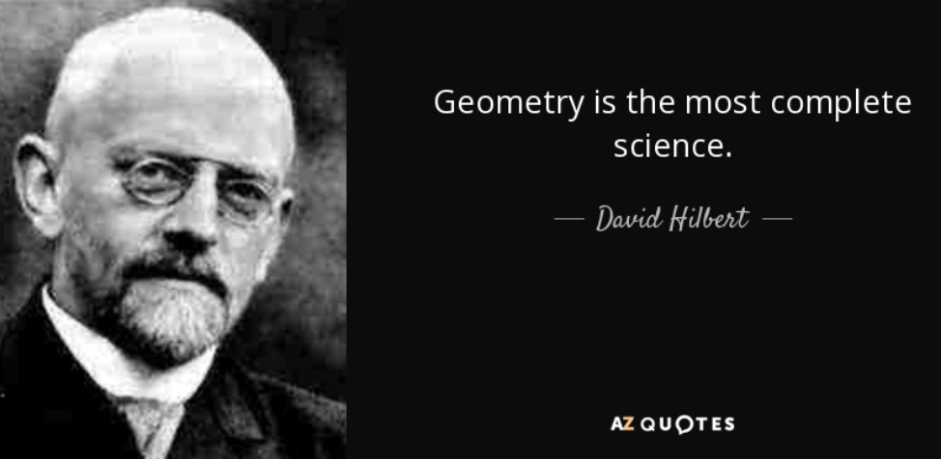
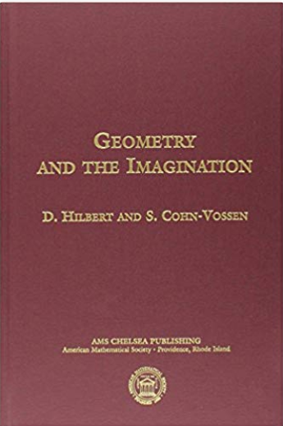

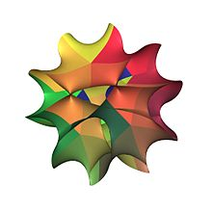

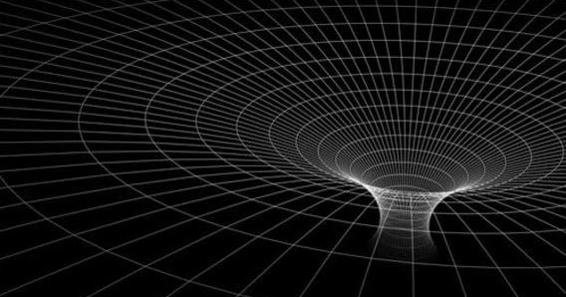
Geometry is an incredibly creative science!

Slide 5
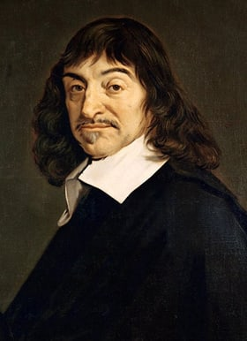
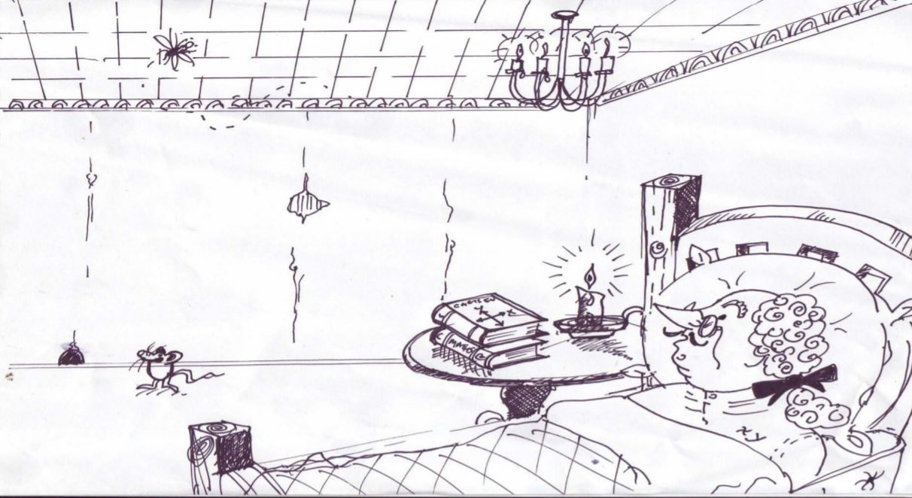
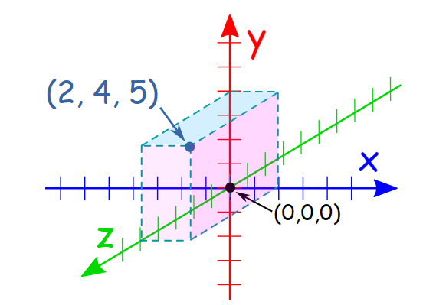
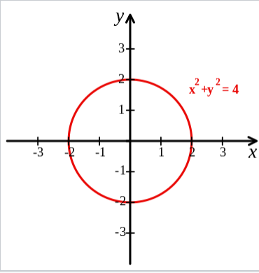
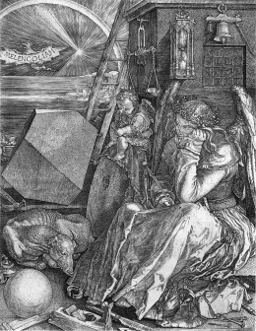
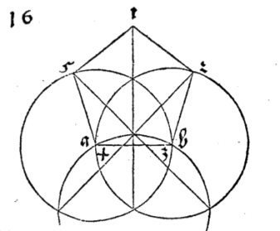
Analytic versus synthetic geometry
Descartes (c1600) introduced the Cartesian coordinates
and calculus in geometry
Notes:
https://divisbyzero.com/2011/03/22/albrecht-durers-ruler-and-compass-constructions/

Slide 6

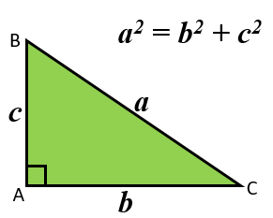
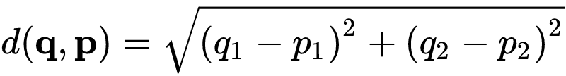
Pythagoras’ / Pythagorean theorem
Yields formula of Euclidean distance in Cartesian coordinate system
Circa 500 BC
At the heart
of the
Euclidean distance
Pythagoras’ theorem allegedly know in Babylonian mathematics (2000-1600 BC)

Slide 7
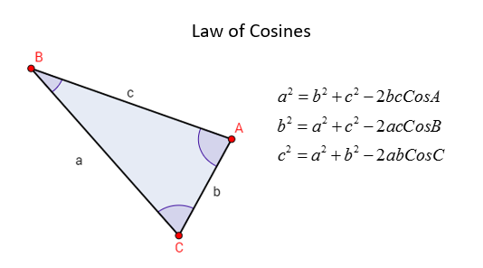
Pythagoras’ theorem generalizes to the law of cosines for arbitrary triangles
We shall see that for Bregman manifolds in information geometry …
… we have dual Pythagorean theorems with generalized law of cosines

Slide 8
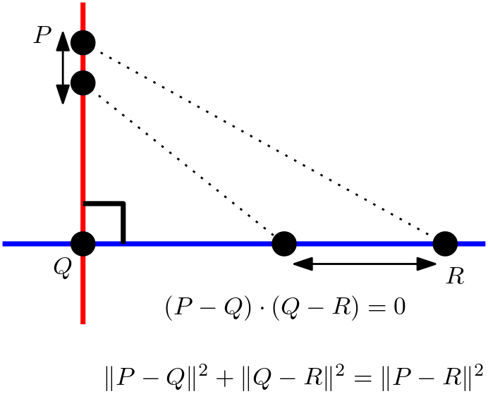
A modern view of Pythagoras’ theorem: A triangle PQR is rectangle if and only if straight lines perpendicular at Q induce distance identity
Squared Euclidean distance

Slide 9
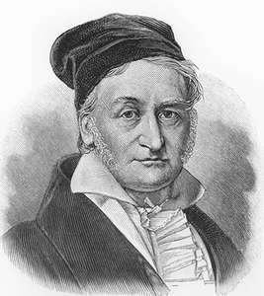
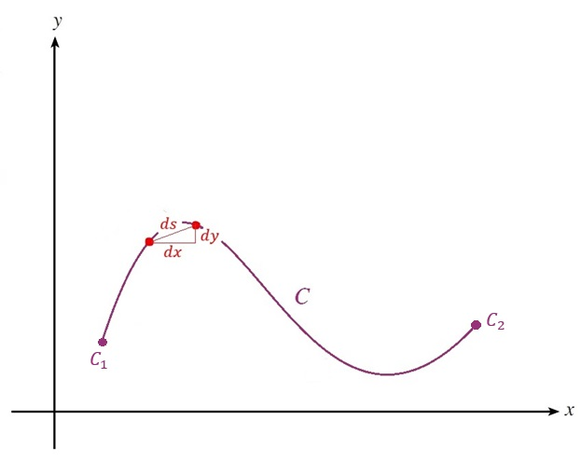
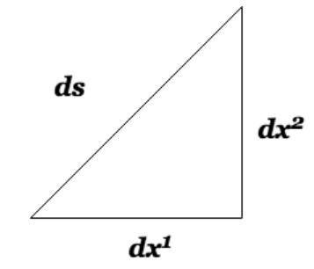
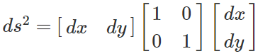
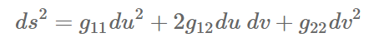
Riemannian differential geometry
Gauss pioneered the study of 3D surfaces and curvature
Gauss
Introduce a positive-definite matrix G
Define a geometric object called a metric tensor
An infinitesimal Pythagoras theorem
Riemann
Length of a curve by integration
Infinitesimal length element:

Slide 10
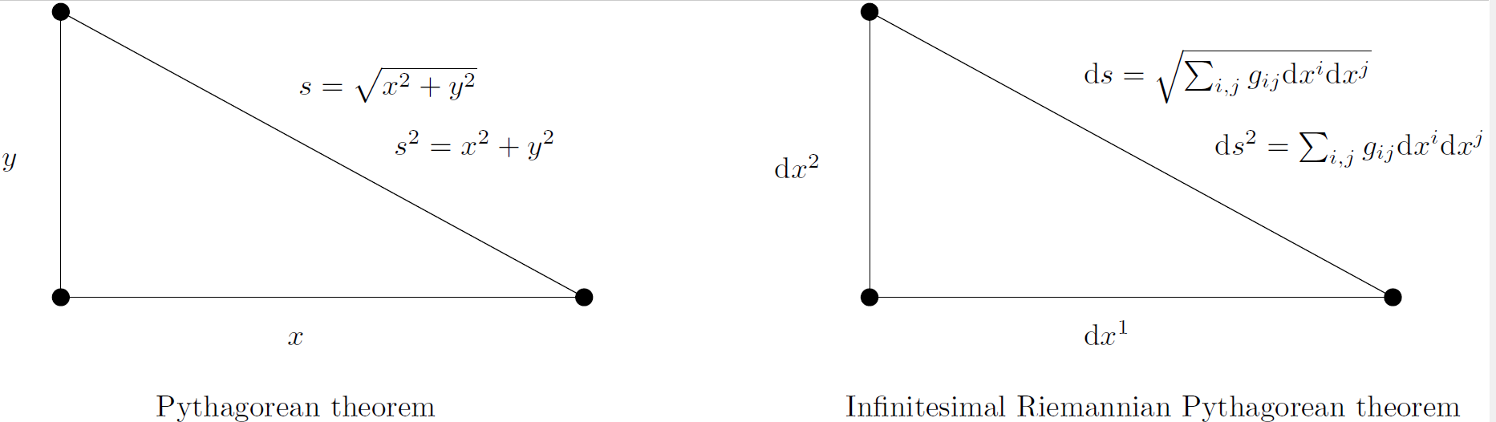
Riemannian geometry: Infinitesimal Pythagorean theorem
Infinitesimal length element ds
Riemannian distance is (locally) length of shortest path

Slide 11
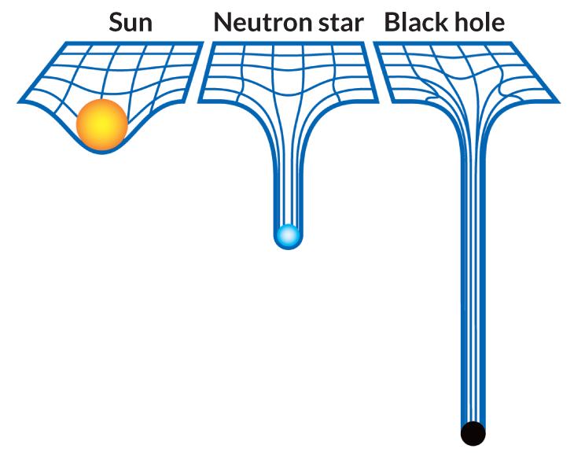
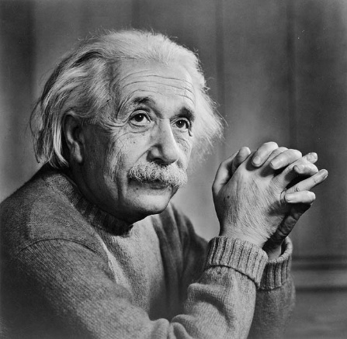
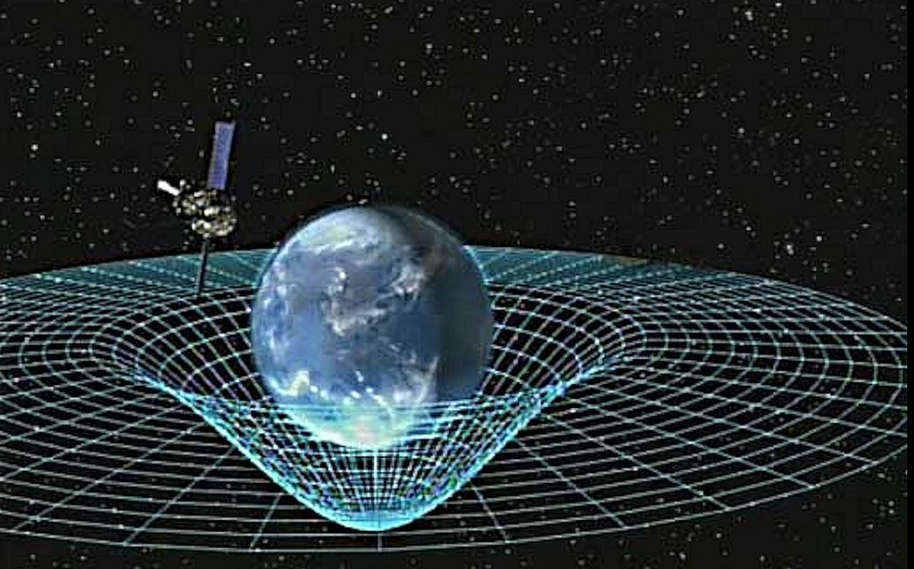
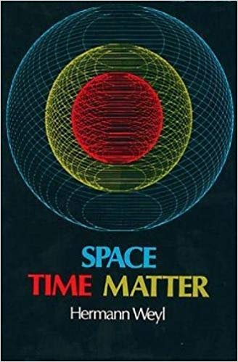
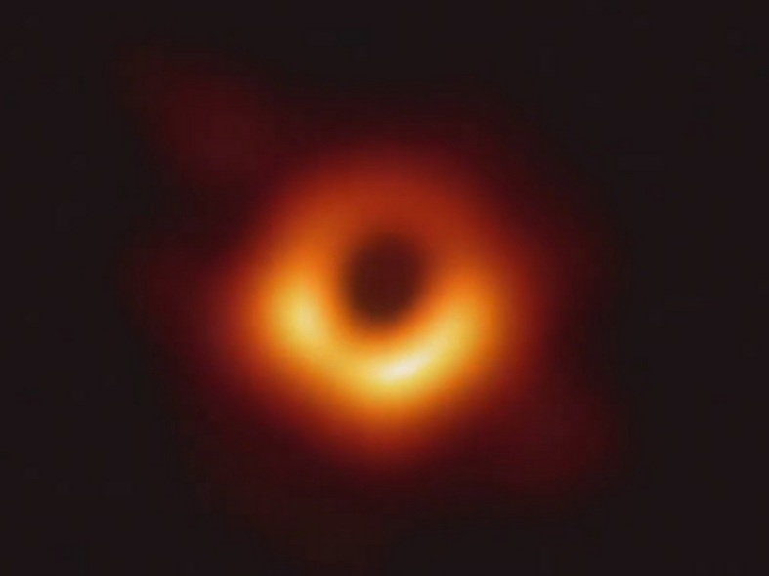
Riemannian geometry: A revolution that changed our perception of the universe and data science
General relativity of spacetime
Spacetime+Matter

Slide 12
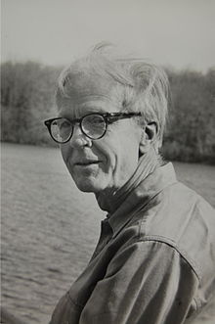
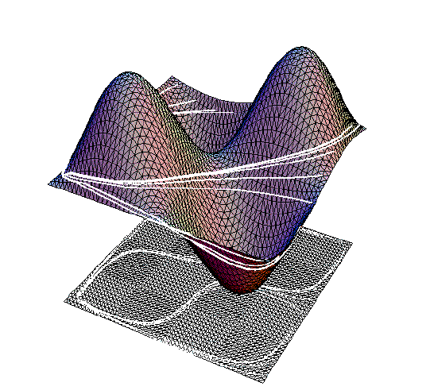
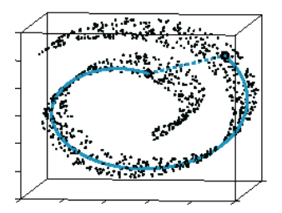
Riemannian manifolds: Extrinsic vs intrinsic views
Visualized extrinsically as smooth surfaces of the ambient Euclidean space: Whitney embedding theorem
Isometric
embedding:
Extrinsic geometry
Hassler Whitney
(1907-1989)
Manifold learning/reconstruction
from data points (Swiss roll)
Intrinsic geometry
Intrinsic geometry versus isometric Whitney embedding (in dim 2D)

Slide 13
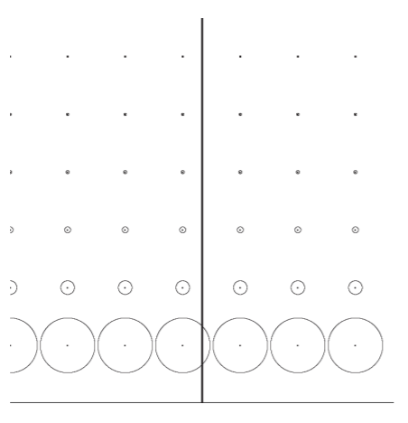
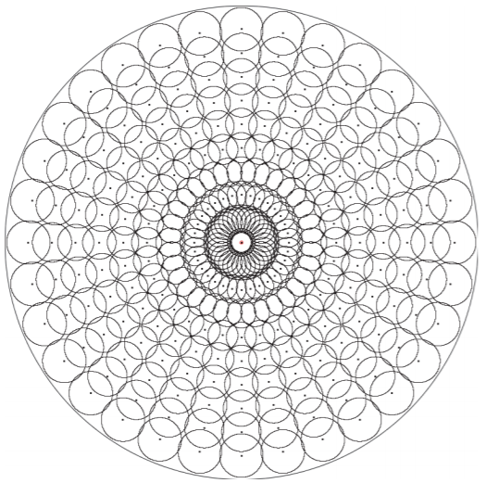
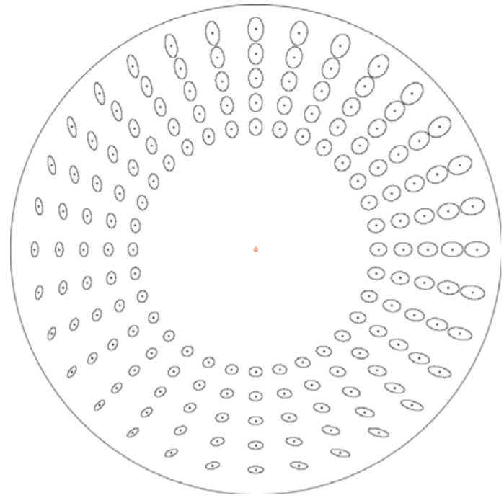
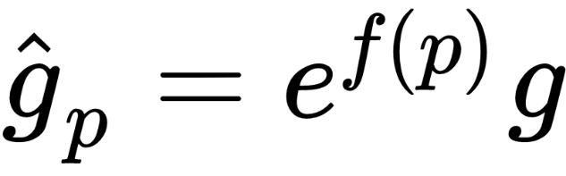
Conformal versus non-conformal metric tensor field: Hyperbolic geometry
Conformal
Not conformal
Conformal
Upper Poincare plane
(conformal)
Poincare disk
(conformal)
Klein disk
(non-conformal)
Metric tensor scaled by positive function:
Conformal: metric tensor a scalar-value function of the Euclidean metric tensor
In conformal geometry, we can measure angles without distortions

Slide 14
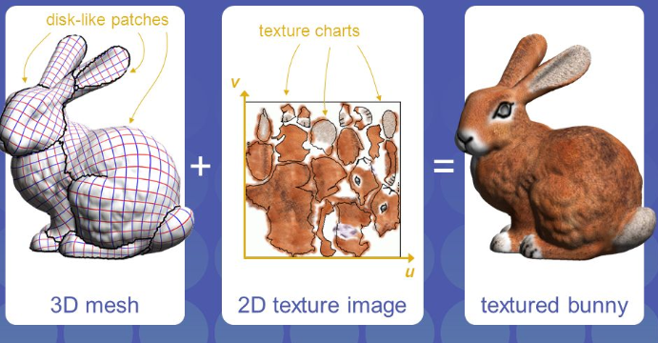
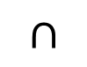
Smooth manifold
Global geometric objects
vs
Local descriptions
in local chart coordinates
M
Locally Euclidean
(homeomorph)
p
V
U
Atlas
Coordinate charts
Φ_{v}
R^{n}
Φ_{u}
Φ_{u} (U V)
$$∩$$
Φ_{v}(V)
Φ_{u}(U)
Φ_{uv}
UV mapping in computer graphics

Slide 15
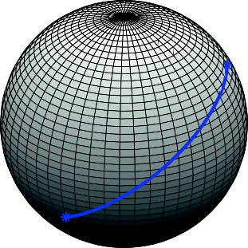
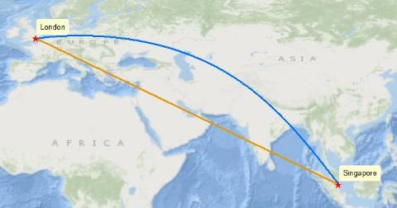
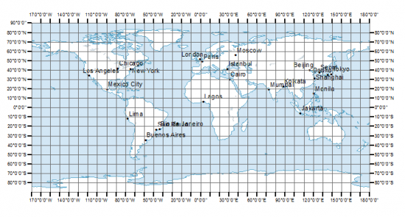
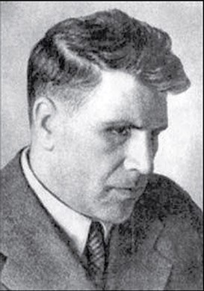
Visualizing (shortest) paths in a chart: (i.e., in local coordinates)
You can only visualize a geometry by rasterizing in a (local) coordinate chart
or drawing (conceptual) figures, or much better imagining it in your head!
Lev Semenovich Pontryagin (1908–1988)
blind by accident at 14 yo

Slide 16
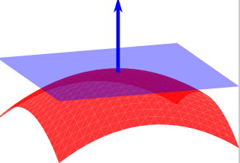
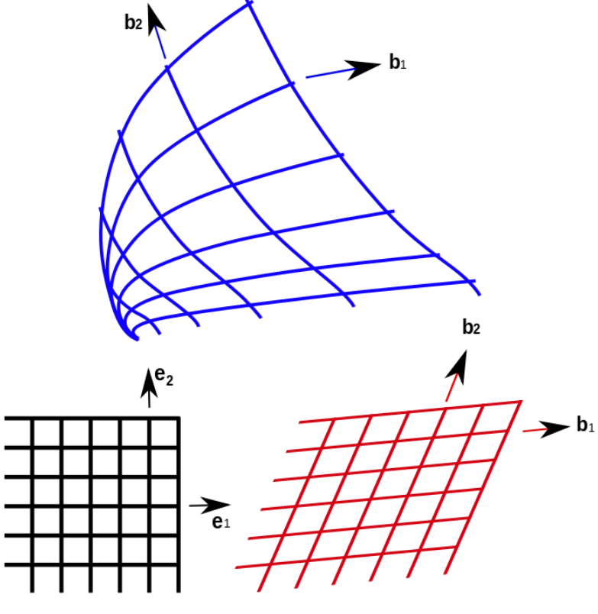
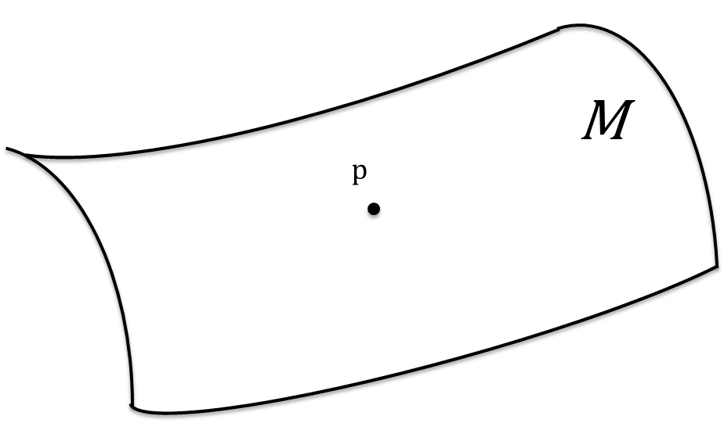


Manifold: Tangent spaces
Tangent space at p : T_{p}M ≅ R^{n}
Tangent vector at p : V(p)
V(p)=$Σi Vi(p)∂$_{i}(p)
Local basis vectors
V(p)
Intrinsic geometry view:
interpret a vector as a
directional derivative and
not as an arrow
T_{p}M

Slide 17




An essential concept: Affine Connection $∇$
Define how to “parallel transport” a vector from one tangent plane to another tangent plane by infinitesimally parallel shifting it along a curve (thus generally depend on the curve)
Use to define $∇$-geodesics as autoparallel curves
V_{p}=V(p)
V(q)
q
$$∇$$
Also provide a way to differentiate
a vector field with respect to another
vector field called the
covariant derivative
$$\dot{γ}$$
γ
https://arxiv.org/abs/1808.08271
Notes:
Discrete Connection and Covariant Derivative for Vector Field Analysis and Design
http://genderi.org/introduction-to-general-relativity-lectures-by-pietro-fr.html

Slide 18






Curvature of a connection $∇$
Cylinder is flat:
Parallel transport is
path-independent
Sphere has constant curved curvature:
Parallel transport is path-dependent
Notes:
https://images.math.cnrs.fr/Visualiser-la-courbure.html?lang=fr

Slide 19





A word about the torsion of $a connection$ $∇$
Torsion measures the speed of rotation of the binormal vector
parallel transport “twists” vectors.
Failing to close a “parallelogram”
Connections differing by torsions have same geodesics
Pregeodesics= geodesic shapes without parameterization
Notes:
https://www.naturelovesmath.com/en/mathematical-physics/general-relativity-loud-and-clear/

Slide 20



Metric-compatible connection $∇$
Preserves the “inner product” of vectors by parallel transport
Preserves the metric
You can measure lengths or angles
consistently at any tangent plane

Slide 21




The fundamental theorem of Riemannian geometry
There exists a unique torsion-free connection that is metric compatible which is called the Levi-Civita connection; The LC metric connection is derived from g
Metric-compatible
$$∇$$
Elie Joseph Cartan
(1869-1951)
Tullio Levi-Civita
(1873-1941)
Riemannian geometry: take the Levi-civita metric connection
Differential geometry: take any affine connection (Elie Cartan)
Information geometry: take a pair of “dual” connections

Slide 22


Rationale for information spaces
In traditional geometry, a space is an empty vacuum
In physics, a spacetime contains matter
(torsion in General Relativity of Einstein-Cartan)
An information space is a space packed with entities/models:
Space of matrices, symmetric matrices, positive-definite matrices
Space of parametric densities, non-parametric densities, positive densities
Etc.
Cone of positive-definite 2x2 matrices visualized in 3D
https://arxiv.org/abs/1604.01592

Slide 23


Rationale for Information Geometry (IG)
What is the/a geometry of the space of Gaussian densities?
Distance, interpolation, closest Gaussian of a subfamily (projection)?
Note that appropriate geometry may depend on applications
IG discovered a dualistic geometry that can also be used in
other non-statistical contexts too!
Applications of the IG framework to information sciences (statistics, information theory, signal processing, machine learning, etc.).
Mainly, because Information Sciences consider asymmetric distances

Slide 24


What is the geometry of the Gaussian manifold?
Euclidean geometry/distance yields this interpretation:
Desiderata: Dissimilarity shall be invariant to reparameterization:
Same distance for parameterizations {N(μ, σ)} or {N(μ, σ2)}
No geometry of the sample space
Furthermore, invariant by “sufficient statistics”
Actually… Optimal Transport geometry of Gaussian manifold yields Euclidean geometry ☺ But OT does not distinguish normal family from any elliptical family ☹
More similar?
Equidistant (Rao distance)

Slide 25







Fisher-Riemannian geometry (1930/1945)
1930
Harold Hotelling
Econometrician
Oswald Veblen,
Advisor of Hotelling
Use Fisher information
for the Riemannian
metric tensor
1945
👑 Cramer-Rao lower bound CRLB
👑 Rao-Blackwellization
👑 Fisher-Rao distance
Cramér-Rao Lower Bound and Information Geometry, 2013
https://arxiv.org/abs/1301.3578
C. R. Rao
Statistician

Slide 26


Population space/parameter space
Example in statistical hypothesis testing: estimate from observations and then classify with respect to divergence to decide which hypothesis.
Geometry needed to build better
Information Sciences:
Deal with model and data
(via empirical distributions)
Deal with model and model
divergence
Wald’s view: All statistical problems are decision problems…

Slide 27





Fisher information metric/matrix (FIM)
$\text{g}\text{(}\text{ξ}\text{)}\text{=}\text{E}\text{ξ}$[$\frac{∂}{∂\text{ξ}i}log⁡(p\text{ξ}\text{)}$ $\frac{∂}{∂\text{ξ}j}log⁡(p\text{ξ}\text{)}$]
g_{ij}(ξ)=$\int{\frac{∂}{∂\text{ξ}i}}log⁡(p\text{ξ}$(x))$\frac{∂}{∂\text{ξ}j}log⁡(p\text{ξ}\text{(}\text{x}\text{))}\text{p}\text{ξ}\text{(}\text{x}\text{)}\text{dx}$
Sir Ronald Fisher
FIM is positive-semidefinite, positive-definite for regular models
1922
Notes:
https://royalsocietypublishing.org/doi/pdf/10.1098/rsta.1922.0009

Slide 28


Geometry of normal distributions: hyperbolic
Pseudo-sphere
(negative curvature -1/2)
Pattern recognition in nuclear fusion data by means of geometric methods in probabilistic spaces, 2017

Slide 29



Hyperbolic geometry for location-scale families
Several models of hyperbolic geometry (Klein, Poincare, Beltrami, pseudosphere)
https://www.youtube.com/watch?v=i9IUzNxeH4o
Visualizing hyperbolic Voronoi diagrams. Symposium on Computational Geometry 2014

Slide 30





Cramer-Rao lower bound (CRLB + Frechet)
The variance of any unbiased estimator is lower bounded
by the inverse of the Fisher information
René Maurice Fréchet
(1878-1973)
Notion of efficiency!
C. R. Rao
The covariance of any unbiased estimator is lower bounded
by the inverse of the Fisher information matrix
(here, positive-definite matrices, Lowner ordering)
Harald Cramer

Slide 31








Examples of statistical models (regular/identifiable)
$𝒩 (μ,σ)$
O = R
E = R $×R+$
σ
Negative
curvature
p(x,μ,σ) ↦(μ,σ)
Upper half-plane
Φ
μ
0
O = $\left\{x1,…,xn\right\}$
𝜉²
(0,0,1)
S_{n}
$$\left\{ξ∈\text{R}n |ξi>0\sum{ξi}=1\right\}$$
(0,1)
E =
S₂
Positive
Curvature:
Multinomial
Multinoulli
Discrete dist.
Categorial dist.
$$\left\{ξ∈\text{R}n+1 |ξi>0\sum{ξi}=1\right\}$$
p(x,ξ¹,…,ξ^{n+1}) ↦(ξ¹,…,ξ^{n})
Simplex
𝜉¹
0
(1,0)
(0,1,0)
Φ
(1,0,0)
Exponential family : p(x,ξ¹,…,ξ^{n})=$e^{C\left(x\right)+ξi}Fi\left(x\right)−ψ(ξ)$ ↦(ξ¹,…,ξ^{n+1})

Slide 32

Non-regular statistical models
Not identifiable models happen often in practice…
Usually, hierarchical models:
Gaussian mixture models (GMMs)
Multi-layer perceptrons (MLP)
Semi-definite matrix: Singular Semi-Riemannian manifolds
Cramer-Rao lower bounds does not hold, need different theory for model selection (BIC, MDL), natural gradient and plateau in learning, etc.
Lightlike Neuromanifolds, Occam's Razor and Deep Learning, arXiv:1905.11027

Slide 33



Statistical curvature (1975)
Use of differential geometry to study the information loss in estimation
Bradley Efron

Slide 34


Dualistic structure of information geometry
8 kinds of geodesic triangles
Two conjugate torsion-free affine connections coupled with the metric
Dual parallel transport is metric-compatible
There is not necessarily a distance, 2^k types of k-gons (eg, 8 triangles)

Slide 35

Dual parallel transport is metric-compatible

Slide 36

Dually flat space: Pythagoras’ theorem
Bregman manifold induced by a
convex function
Two (affine) coordinate systems coupled by Legendre-Fenchel transformation
Two dually flat connections with respect to the metric tensor
Canonical distance = Bregman divergence induced by convex generator F
Bregman manifold (a type of Hessian manifold)
Generalize Euclidean space, very practical for computing!

Slide 37
From any dualistic structure… … to a 1-family of duality structures: α-geometries
Notion of
Amari-Chentsov
cubic tensor
How to choose α depending on applications?

Slide 38

From a dualistic structure to a 1-family of dually structures
Let $(M,g,∇,$ $∇$*) be a dualistic structure: A dual pair of connections coupled to the metric so that dual parallel transport is metric-compatible
We can build a 1-family of dualistic structures $(M,g, ∇^{\text{−}\text{α}},$ $∇^{\text{α}}$)
so that $\frac{∇^{\text{−}\text{α}}+∇^{\text{α}}}{2}$=$∇0=∇LC$
No distance associated with the dualistic structure.
In particular, when $\text{α}$=0, $(M,g, ∇^{\text{0}},$ $∇^{\text{0}}$) = $(M,g$) the Riemannian geometry. Thus information geometry generalizes (Fisher-Rao) Riemannian geometry

Slide 39



Amari’s expected α-geometry
Given a parametric family of distributions, consider the Fisher information matrix and a family of connections: α connections
Exponential e-mixture connection and m-mixture connection
$gpξ(∇α∂i∂j$(p $ξ$),$∂k$(p $ξ$))=Γ^{α}_{ijk}(p $ξ$)=E $ξ$[($\frac{∂}{∂\text{ξ}i}$ $\frac{∂}{∂\text{ξ}j}log⁡(p\text{ξ}\text{)}\text{+}\frac{1−α}{2}\frac{∂}{∂\text{ξ}i}log⁡(p\text{ξ}\text{)}$ $\frac{∂}{∂\text{ξ}j}log⁡(p\text{ξ}\text{)}\text{)}\frac{∂}{∂\text{ξ}k}log⁡(p\text{ξ}\text{)}$]
No associated distance in the alpha-expected geometry
Levi-Civita connection : $∇0=∇LC$
https://arxiv.org/abs/1808.08271

Slide 40






How to get initial dual expected connections?
Historically, built the e-connection (exponential, $\text{α}$=1) and
m-connection (mixture, $\text{α}$=-1) for statistical models
Log-likelihood
e-connection
m-connection
Dual connections with respect to the Fisher information (Riemannian) metric

Slide 41


Example of dual e-/m-connections for the univariate Gaussian 2D manifold
Misconception: The m-geodesic between two Gaussians of a Gaussian
manifold is a Gaussian (and not a mixture of Gaussian!)
The Gaussian is obtained from linear interpolation on the moment parameters

Slide 42




Dualistic structure of the Gaussian manifold
∇: e-connection
∇*:m-connection

Slide 43



Dual connections from any divergence!
$(M,{}_{D}^{}g,{}_{D}^{}∇,$ ${}_{D}^{}∇$*)
Dual connections from any smooth parametric distance,
called a (parameter) divergence D: D is not necessarily symmetric
a tensor metric g: g_{ij}(p_{ξ})=$\frac{∂}{∂\text{ξ}i1}\frac{∂}{∂\text{ξ}j}$₂D(p_{ξ1},p_{ξ2})|_{ξ1=ξ2=ξ}
a torsion-less affine connection $∇$:
Γ_{ijk}(p $ξ$)$=−\frac{∂}{∂\text{ξ}i1}\frac{∂}{∂\text{ξ}j2}\frac{∂}{∂\text{ξ}k2}$D(p_{ξ1},p_{ξ2})|_{ξ1=ξ2=ξ}
D*(p_{ξ1},p_{ξ2})$=\text{D}\text{(}\text{p}\text{ξ}\text{2}\text{,}\text{p}\text{ξ}\text{1}\text{)}$
Dual divergences
and dual connections
Symmetric divergences yields the same connection:
The Levi-Civita connection

Slide 44


Many distances/divergences in information sciences
Divergence= discrepancy, dissimilarity, deviance between two probability distributions
Also nowadays, smooth parametric dissimilarities (contrast function)
Distance is often thought as
a metric distance:

Slide 45


Divergences: Statistical distances
In information theory, relative entropy called Kullback-Leibler divergence
Can be extended to f-divergences
Properties: Distances can be scale-invariant (eg, Itakura-Saito), homogeneous, projective (work on unnormalized probability densities), etc.

Slide 46

Organize dissimilarities in (exhaustive) classes

Slide 47



Invariant divergence = f-divergences
Lump or coarse-bin a separable distance, and ask for
information monotonicity
Theorem: The only monotone separable divergences are f-divergences
(except for the curious case of binary alphabets)
f-divergences are invariant by diffeormorphisms of the sample space

Slide 48

Statistical invariance
Fisher-Rao distance is independent of parameterization (but FIM is covariant!)
Same Fisher-Rao distance for parameterizations {N(μ, σ)} or {N(μ, σ2)}
Fisher information metric is the only invariant metric tensor (up to a scale factor)
Metric tensor induced by any standard f-divergence coincides with the Fisher information metric
Dual connections induced by any f-divergence yield expected alpha-connections

Slide 49


Recommended textbooks + overview survey
An elementary introduction
to information geometry
https://arxiv.org/abs/1808.08271
2016
Very nice up-to-date survey including
Applications by the pioneer S.-i. Amari
2014
More details on differential geometry
with exercices

Slide 50



Prerequisite: Information sciences + Differential geometry
Tensors + Manifolds
Statistics + Information theory

Slide 51
Outline of the lectures:
Introduction and overview of the dualistic structures (these slides)
Background:
Probability and statistics
Information theory
Differential geometry
Distances
Information-geometric manifolds
Fisher-Rao Riemannian manifolds
Manifolds with dual connections coupled to the metric
Bregman manifolds
Geometry of mixture families with applications
Information geometry in action:
Natural gradient descent methods and deep learning
Clustering
Bayesian hypothesis testing
Advanced topics, limitations and perspectives

Slide 52




Thank you.
https://franknielsen.github.io/
http://forum.cs-dc.org/category/72/geometric-science-of-information

Slide 53

Genesis of an information-geometric structure
https://arxiv.org/abs/1808.08271

Slide 54
Background
Probability and statistical inference
Measures, random variables, Fisher information, exponential families
Information theory and maximum entropy
Entropy, relative entropy (Kullback-Leibler divergence), maximum entropy principle
Distances
Metrics, divergences, properties, information monotonicity, parametric families, f-divergences, Bregman divergences, Jensen divergences
Geometry
Algebraic structures (dual vector/covector spaces, tensors), affine space, differential geometry (Riemannian, affine: uncoupling metric/connection)

Slide 55






Applications
Singularities in neuromanifolds

Slide 56




Shape Retrieval Using Hierarchical Total Bregman Soft Clustering
t-center:
Robust to noise/outliers
IEEE TPAMI 34, 2012

Slide 57





Total Bregman divergence and its applications to DTI analysis
IEEE Transactions on medical imaging, 30(2), 475-483, 2010.

Slide 58






The origin of dual connections
Aleksander P. Norden (1904-1993), relative geometry
(equiaffine torsion-free connection)
Russian book "Spaces with an affine connection" (1976)
Rabindra Nath Sen (1896-1974), “Senian geometry”
Nomizu and Sasaki’s Affine differential geometry (geometry of immersions)
Information geometry (Chentsov’s category approach and Amari)
Wong’s optimal transport and c-divergences
Norden
Sen
Nomizu
Amari

Slide 59
Geometry and its language affordance
What is geometry?
Science of measurements
Science of figures (ruler and compass construction)
Axioms, consistency and deductive theorems (Euclidean/hyperbolic)
Science of invariance (congruence of figures/Erlangen program)
Etc.
Geometry has its own human language for reasoning
What is the distance between two points?
What is the midpoint between two points?
What is the closest point of a surface from a given point? (projection)
Balls and space of balls binary operations (CSG construction)

Slide 60
Acknowledgements
My collaborators (incl. Jean-Daniel Boissonnat, Gaetan Hadjeres, Richard Nock, Ke Sun, Olivier Schwander, and all my co-authors!)
Images of these slides were mostly courtesy of the Internet.
© Copyrights hold by their respective owners
Some figures were drawn in PowerPoint by Joffrey Poitevin

Slide 61
Background for Information Geometry
Probability and statistics
Information theory
Elements of differential geometry
Distances, divergences and entropies
Frank Nielsen
An elementary introduction to information geometry
https://arxiv.org/abs/1808.08271

Slide 62


Probability and statistics
Background
Frank Nielsen

Slide 63





Outline
Classic probability theory
Modern theory of probability measures
Statistical inference:
method of moments,
Maximum Likelihood Estimator (MLE),
sufficient statistics,
Fisher information (with curvature interpretation)
Exponential families
Pierre de Fermat
Jacob Bernoulli
Kolmogorov
Sir Ronald Fisher
Barndorff-Nielsen

Slide 64




Discrete random variables
Jacob Bernoulli
(1654,1705)
Bernoulli distribution (coin tossing), binomial distribution (tossing a coin n times), multinomial distribution (throwing a dice n times), Poisson distributions, etc.
Sample space and probability of events:
Probability mass function
(pmf)
Cumulative distribution function (CDF)
Expectation
Variance

Slide 65






Discrete random variable
Siméon Denis Poisson
(1781–1840)
Poisson distribution with support 0, 1, 2, 3, …
Probability mass function:
Cumulative distribution function
Mean and variance:
Notes:
https://www.umass.edu/wsp/resources/poisson/

Slide 66











Continuous random variable
Probability density function (PDF)
Normal or Gaussian distribution
A location-scale distribution:
CDF of standard normal distribution N(0,1)
Expectation and moments
1777-1855
Riemann
integral

Slide 67







Continuous random variable
Lorentzian/Cauchy PDF:
CDF:
Cauchy distributions do not have finite moments of any order! No expectation (bcs of improper integral)
Location-scale family, standard Cauchy
Augustin-Louis Cauchy
(1789-1857)

Slide 68





Probability measures
additive law of probability for possibly countably infinite pairwise mutually exclusive events
Interpreted as volumes of events for disjoint events
But Banach-Tarsky's paradox kicks in: for an uncountably sample space there exists a set S which can be partitioned into two disjoint congruent sets S1 and such that

Slide 69


Measure theory: σ-algebra (of events)
Pb: Cannot consider the full power set for continuous sample spaces
Let us define an algebra of measurable events: the σ-algebra
σ-algebra generated/induced by a set S:
=Smallest σ-algebra with respect to set inclusion

Slide 70








Measure space
Borel sets : =σ-algebra generated by all open intervals
Counting measure: σ-algebra is the power set and the measure is defined by cardinality
Lebesgue measure:
Volume for open boxes
Notes:
In the probability space there are subsets that are not measurable

Slide 71







Measurable function and simple functions
Consider two measurable spaces:
Preimage:
Measurable function:
If and only if the preimages are in for all B
Indicator function:
Simple function:

Slide 72





Lebesgue integration
Riemann integral (signed area under the curve) not enough!
(compact, problem with limits, etc.)
Integral of a simple function:
Other notations:
Integral of positive measurable functions:
In general, for a measure, decompose into positive/negative measures:
Henri Léon Lebesgue
(1875-1941)

Slide 73




Random variables and expectations
A random variable X is a real-valued measurable function:
Probability:
Bonus: The expectation of a discrete or a continuous random variable writes similarly using probability measure theory:

Slide 74









Density and dominating measure
For a measure space and a measurable function f, define
the measure
For example, the Gaussian density is formed from the Lebesgue density
Absolute continuity:
is dominated by
Let then
Notes:
\mathrm{supp}(\nu)\subseteq \mathrm{supp}(\mu)

Slide 75




Radon-Nikodym theorem and RN density
Many properties:

Slide 76


Statistical inference: Estimators
Given n independent and identically distributed (iid) observations, estimate the underlying distribution (probability density)
Idea: Assume the density is parametric
One of the oldest method is the method of moments:
Simply match the distribution moments with the sample moments
Infinitely many (point) estimators! Which one is best?
Pafnuty Chebyshev
(1821-1894)

Slide 77










Maximum likelihood estimator (MLE)
Parametric family:
Likelihood function: Function of the parameter
Maximum likelihood estimate:
Consistent method: converge in probability to the true value

Slide 78



Fisher information
FI measures the amount of information that an observable random variable X carries about an unknown parameter θ
Fisher information interpreted as the curvature of the graph of the log-likelihood: Near the MLE, high Fisher information indicates that the maximum is sharp, low Fisher information indicates that the maximum is shallow (many nearby values with a similar log-likelihood).
Notes:
https://www.gaussianwaves.com/2012/10/score-and-fisher-information-estimator-sensitivity/

Slide 79


Cramer-Rao lower bound (CRLB): Univariate case
The variance of any unbiased estimator is lower bounded by the inverse of the Fisher information:
Fisher information:
Cramer-Rao lower bound and information geometry. Connected at Infinity II, 2013.

Slide 80





Cramer-Rao lower bound: Multivariate case
Löwner partial ordering on positive-semi-definite matrices:
CRLB Theorem:
Under regularity conditions:
Equivalent representation of the FIM
Cramer-Rao lower bound and information geometry. Connected at Infinity II, 2013.

Slide 81



Properties of the Maximum Likelihood Estimator (MLE)
Consistency:
Efficiency: Variance of estimator matches the Cramer-Rao lower bound (CRLB)
Equivariance: MLE estimator of Gaussian variance σ2 is equivariant to MLE estimator of deviation σ
Asymptotic normality (convergence in distribution):

Slide 82

Some properties of the Fisher Information Matrix
Positive semi-definite FIM
Positive-definite FIM for regular models (=identifiable)
FIM is invariant under reparametrizations of the sample space X.
Covariant under reparameterization (later, a 2-covariant tensor metric…)

Slide 83

Regular versus non-regular models
Regular models: 1-to-1 correspondence of parameters with distributions
Hierarchical models are usually non-regulars (eg., mixtures, multilayer perceptron)
Multiple Layer Perceptron
(MLP)

Slide 84


Key concept: Sufficient statistics
A statistic is a function of a random vector (e.g., mean, variance)
A sufficient statistic collect and concentrate from a random sample all necessary information for recovering/estimating the parameters.
Informally, a statistical lossless compression scheme…
Definition: conditional distribution of X given t does not depend on θ
Fisher-Neyman factorization theorem: Statistic t(x) sufficient iff. the density can be decomposed as:
Statistical exponential families: A digest with flash cards, arXiv:0911.4863 (2009)

Slide 85


Example of sufficient statistics:
Fisher-Neyman factorization:
For Poisson distributions of intensity λ:

Slide 86



Natural exponential families (NEF)
Consider a positive measure
An exponential family is a parametric family of densities that write as
where F is real-analytic, strictly convex and differentiable:
F: Log-normalizer (also known as partition function, cumulant function, etc.)
Log-Laplace transform
Natural parameter space

Slide 87


Exponential families (from Natural EFs to EFs)
Consider a (sufficient) statistic t(x)
Consider an additional carrier measure term k(x)
Consider an inner product between t(x) and θ
(usual scalar/dot product)
Properties:
Exponential families have finite moments of any order
Notes:
\def\inner#1#2{{\langle #1, #2\rangle}}
p_{\theta}(x)= \exp(\inner{\theta}{t(x)}-F(\theta)+k(x))

Slide 88

Many common distributions are exponential families in disguise

Slide 89




Maximum likelihood estimator for exponential families
Average log-likelihood:
MLE equation

Slide 90







Regular EFs and steepness of exponential families
An exponential family is regular when the natural parameter space is open
Closed convex hull of {t(x)}:
Map is one-to-one
Consider the expectation/moment parameter space:
Family is steep if
MLE exists and is unique for regular and steep EFs when
Example of non-steep family: Singly-truncated Gaussian family
Notes:
\Theta=\mathrm{int}(\Theta)

Slide 91




Dual moment/expectation parameterization
For a regular EF density, let
denote the dual parameterization
Related to the Legendre-Fenchel convex conjugate:
Moreau biconjugate theorem: when F is proper, lower semi-continuous, and convex function:
Legendre transformation and information geometry, 2010.

Slide 92

Dual parameterization of exponential families

Slide 93




Legendre-Fenchel conjugate
We have and
The convex conjugate is defined by:
Crouzeix identity for convex conjugates
The identity matrix
Crouzeix, J.P. A Relationship Between The Second Derivatives of a Convex Function and of Its Conjugate.
Math. Program. 1977, 3, 364–365.
Notes:
A_{F,F^`}(\theta_1:\eta_2)=F(\theta_1)+F^*(\eta_2)-\theta_1^\top\eta_2
B_F(\theta_1:\theta_2)=F(\theta_1)-F(\theta_2)-(\theta_1-\theta_2)^\top\nabla F(\theta_2)
B_F(\theta_1:\theta_2)=A_{F,F^*}(\theta_1:\eta_2)

Slide 94


Convex conjugates at the heart of Bregman manifolds
Young’s inequality states that
It yields the Fenchel-Young divergence:
…. that is equivalent to a Bregman divergence:

Slide 95

Bernoulli family
Order 1
Statistical exponential families: A digest with flash cards. arXiv:0911.4863 (2009)

Slide 96

Univariate Gaussian family
Order 2
Statistical exponential families: A digest with flash cards. arXiv:0911.4863 (2009)

Slide 97

Poisson family
Order 1
Statistical exponential families: A digest with flash cards. arXiv:0911.4863 (2009)

Slide 98



Multivariate Gaussian family
Order
Compound parameter:
Vector part
Matrix part
Inner product defined by:
Statistical exponential families: A digest with flash cards. arXiv:0911.4863 (2009)
On the Jensen–Shannon Symmetrization of Distances Relying on Abstract Means, Entropy 2019

Slide 99
Summary
Probability measure bypasses the Banach-Tarsky paradox by fixing a σ-algebra of measurable events, and unifies discrete/continuous random variables as measurable functions
Fisher information (FI) measures the sensitivity of the log-likelihood (curvature), invariant to reparametrization of sample space, covariant to reparameterization of parameter space
Cramer-Rao bound provides a lower bound on the variance of unbiased estimator (non-asymptotic) based on the inverse of FI
MLE has asymptotic normality for regular models
Sufficient statistics is statistical lossless compression of random vectors
Exponential families: Dual parameterizations via Legendre-Fenchel conjugation, MLE in closed-form in dual moment parameterization

Slide 100

Information Theory
Background
Frank Nielsen

Slide 101
Outline
Shannon entropy and differential entropy
Relative entropy known as the Kullback-Leibler divergence
Maximum entropy principle
MaxEnt distributions = exponential families
Bounding the differential entropy of statistical mixtures
Kullback-Leibler divergence of location-scale families

Slide 102


Shannon’s entropy
Quantifies the uncertainty of a discrete random variable X
Can be derived axiomatically from Kinchin’s axioms

Slide 103

Shannon’s entropy is a concave function
Always positive
Bounded by log(n)
Finite for fixed-size alphabets
The negentropy is called Shannon information (= a convex function)

Slide 104



Differential entropy is different from discrete entropy
Can be negative : e.g., Gaussian distributions
Can be infinite when the integral diverges
For Dirac distribution, the entropy is:
NB: For Gaussian distributions, the entropy is independent of location
Notes:
\frac{1}{2} \log \left(2 \pi e \sigma^{2}\right)

Slide 105


Entropy of a probability measure
Random variable (=measurable function)
With Radon-Nikodym derivative with respect to to base measure μ:
Unifies:
discrete entropy (counting measure)
differential entropy (Lebesgue measure)
Notes:
\def\dP{\mathrm{d}P}
\def\dmu{\mathrm{d}\mu}
H(X)=-\int_\calX \log\frac{\dP}{\dmu}\dP

Slide 106





Relative entropy: Kullback-Leibler divergence (KLD)
Cross-entropy:
KLD = Relative entropy with respect to a reference distribution P
Not a metric distance because (1) asymmetric and (2) failing the triangle inequality
KLD is an oriented distance!

Slide 107




Entropy for discrete/continuous exponential families
without carrier term k(x)
Using natural parameter θ:
Using expectation parameter η:
Entropies and cross-entropies of exponential families, IEEE ICIP 2010
Notes:
\exp\left(\sum_{i=1}^D t_i(x)\theta_i -F(\theta) + k(x) \right)

Slide 108


Kullback-Leibler divergence for exponential families Fenchel-Young divergence for exponential families
Fenchel-Young divergence (on mixed parameters):
Bregman divergence (on natural/expectation parameters):

Slide 109



Jaynes’ maximum entropy principle (MaxEnt)
Jaynes's principle of maximum ignorance:
Underconstrained optimization problem
Edwin Thompson Jaynes
(1922–1998)
Maximizing a concave function subject to linear constraints
(or equivalently convex mininimization optimization problem).
Notes:
\max_p h(p)= \sum_x p(x)\log \frac{1}{p(x)}

Slide 110


MaxEnt with Kullback-Leibler divergence and with a prior constraint distribution q
MaxEnt is KL left-sided minimization
Maximum entropy distribution is the uniform prior:

Slide 111






MaxEnt distributions (Boltzmann-Gibbs)
Solving the constrained optimization problem:
Use Lagrange multipliers θ (but θ not in closed form)
Ludwig
Boltzmann
Josiah Willard
Gibbs
Gibbs distribution, Maxwell-Boltzmann distribution in statistical mechanics:
Gibbs distribution in statistical physics,
Titled distribution in probability, etc.
MaxEnt distributions are exponential families
Free enery
log-partition
cumulant function
Log-normalizer:
Prior q gives the carrier measure:

Slide 112






Example: Fixed mean and fixed variance MaxEnt distribution
Find the MaxEnt distributions with support the full real line and the first two moments prescribed
Gaussian
family
Notes:
p(x) \propto \exp(\theta_1 x+\theta_2 x^2)

Slide 113


MLE as a right-sided KLD minimization
Recall that MaxEnt is KL left-sided minimization:
Empirical distribution:
MLE is KL right-sided minimization

Slide 114





Upper bounding the differential entropy of mixtures (1/2)
Key idea: compute the differential entropy of an exponential family with given sufficient statistics in closed form. Since it is a MaxEnt distribution, any other distribution with the same moment expectations has less entropy. In particular, this observation applies to statistical mixtures.
Absolute Monomial Exponential Family (AMEF):
with log-normalizer
MaxEnt Upper Bounds for the Differential Entropy of Univariate Continuous Distributions,
IEEE SPL 2017, arxiv:1612.02954
https://www.lix.polytechnique.fr/~nielsen/MEUB/

Slide 115







Upper bounding the differential entropy of mixtures (2/2)
Density of a Gaussian Mixture Model (GMM):
MaxEnt distribution is Laplacian distribution
MaxEnt distribution is Gaussian distribution

Slide 116

A series of upper bounds for h(GMMs)
Zero-centered Gaussian Mixture Models:
MaxEnt Upper Bounds for the Differential Entropy of Univariate Continuous Distributions,
IEEE SPL 2017, arxiv:1612.02954

Slide 117


Computing non-central absolute geometric moments of Gaussians and GMMs

Slide 118



Computing the Kullback-Leibler divergence…
In theory, Risch semi-algorithm reports whether a definite integral has a closed-form or not. Notice that the KLD can also diverge.
Symbolic calculations
For example: Cauchy location-scale families .
Symmetric KL
A closed-form formula for the Kullback-Leibler divergence between Cauchy distributions, arXiv:1905.10965

Slide 119





Kullback-Leibler divergence: Location-scale families
Location-scale group:
Interesting properties for the KL minimization:
On the Kullback-Leibler divergence between location-scale densities, arXiv:1904.10428

Slide 120




Mutual information of RVs (MI)
Consider two random variables X and Y.
There are independent if and only if
Amount of mutual information quantified as the KL divergence between the joint distribution and the product of distributions
MI is not a metric distance but a symmetric distance between random variables
Notes:
I(X ; Y)= {\mathrm{KL}}\left(P_{(X, Y)} \| P_{X}{Y}\right)

Slide 121



Elements of differential geometry
∇
Jean-Louis Koszul
(1921-2018)
Charles Ehresmann
(1905-1979)
Elie Cartan
1869-1951
Frank Nielsen
Notes:
https://colindcarroll.com/2019/01/29/notes-on-differential-geometry/

Slide 122

Outline
Vector space and dual covector space
Inner product space and metric tensor
(contravariant and covariant coordinates)
Tensor fields
Affine connection
Riemannian metric connection

Slide 123
Finite dimensional real vector spaces
A real vector space is a set X with a special element 0, and three operations :
Addition: Given two elements x, y in X, one can form the sum x+y, which is also an element of X.
Inverse: Given an element x in X, one can form the inverse -x, which is also an element of X.
Scalar multiplication: Given an element x in X and a real number c, one can form the product cx, which is also an element of X.
Operations must satisfy the following axioms:
Additive axioms. For every x,y,z in X, we have
x+y = y+x.
(x+y)+z = x+(y+z).
0+x = x+0 = x.
(-x) + x = x + (-x) = 0.
Multiplicative axioms. For every x in X and real numbers c,d, we have
0x = 0
1x = x
(cd)x = c(dx)
Distributive axioms. For every x,y in X and real numbers c,d, we have
c(x+y) = cx + cy.
(c+d)x = cx +dx.

Slide 124






Bases and dimension of a vector space V
A set of D vectors is linearly independent iff
A basis is a set of maximal linearly independent vectors (wrt. set inclusion)
The dimension of the vector space is the cardinality of any basis (finite dimensional case)
Vector v written in a basis B using coefficients/components:
Einstein summation
convention
Notes:
\sum_{i=1}^D \lambda_i b_i=0$ iff $\lambda_i=0, \forall i\in [D]
v_{[B]}=(v^1,\ldots, v^d)
v=\sum_{i=1}^d v^ie_i= v^ie_i

Slide 125








Dual vector space V*: Vector space of covectors
Linear form: Linear mapping
Dual vector space V* = vector space of real-valued linear mappings
Same dimension:
Isomophism
Dual covector basis: We have
Choose covector basis which reads vector components:
Notes:
\omega: V\rightarrow \mathbb{R}
\underline{\omega}: V\rightarrow \mathbb{R}
\mathrm{dim}(V)=\mathrm{dim}(V^*)
V\simeq V^*
\omega(v)=v^i\omega(e_i)
\omega(v)=\omega_i \underline{e}^i(v),\ \omega_i=\underline{\omega}(e_i) \underline{e}^i(e_j)=\delta_j^i

Slide 126






Pairing product of a covector with a vector
Basis in vector space
Basis in covector space
Pairing
product
By notational definition:
Vector components:
Covector components
Notes:
v^
\omega_i=(\omega,e_i\ranglei=(e^ i,v\rangle
\omega_i=(\omega,e_i\rangle
B=\{e_1,\ldots, e_d\}
e^i(e_j)=(e^i,e_j\rangle=\delta_j^ i

Slide 127



Inner product space: notion of lengths/angles/orthogonality of vectors
Orthogonality
Notes:
v_1\perp p_2 \Leftrightarrow \langle v_1,v_2\rangle =0

Slide 128


Norm and distance induced by an inner product
Length of a vector v is its norm
Distance (metric) induced by a norm:
Notes:
D(v_1,v_2)=\|v_1-v_2\|

Slide 129



Reciprocal basis is a basis of vectors
Given an inner product <.,.>, we can define a reciprocal basis of V
The coefficients of a vector v in the primal basis are called the contravariant coefficients:
The coefficients of a vector v in the reciprocal basis are called the covariant coefficients:
primal and reciprocal basis are mutually orthogonal
Notes:
e^j\in V\ \mbox{such that }\ \langle e_i, e^ j\rangle=\delta_i^ j

Slide 130




Geometric reading the covariant/contravariant coefficients/components of a vector
contravariant
covariant
Abide rules of change of basis
In a Cartesian orthonormal coordinate system,
the contravariant components match
the covariant components
Notes:
v^i=\langle v,e_i\rangle
v_i=\langle v,e^i\rangle

Slide 131

Primal and reciprocal basis are mutually orthogonal

Slide 132





Scalar product and dual metric tensors
Scalars are tensors of order 0
Vectors are contravariant tensors of order 1
Covectors are covariant tensors of order 1
Notes:
\lang
\def\inner#1#2{{\langle #1,#2 \rangle}}\begin{eqnarray*}
g_{ij}& =&\inner{e_i}{e_j},\\
{g^*}^{ij}&=&g^{ij}=\inner{{e}^i}{{e}^j}.
\end{eqnarray*}le u,v\rangle = u^iv_i = u_iv^ i

Slide 133



Converting covariant ↔ contravariant components
Raising and lowering indices
Notes:
v_i=g_{ij} v^I
v^i=g^{ij}v_i

Slide 134




Geometric tensors and tensor algebra
Informally, tensor = multi-array of coefficients…
Got attention in the media in deep learning with TensorFlow
But tensors are geometric objects interpreted as multilinear maps
A tensor of type (r,s)
Components/coefficients
with respect to a basis
Later, we shall see that g is a 2-covariant tensor:
Notes:
T: \underbrace{V^*\ldots V^*}_{r}\times \underbrace{V\times\ldots V}_{s} \rightarrow \mathbb{R}
g = g_{ij} d
x_i \otimes d x_j

Slide 135


Riemannian metric tensor g
On a manifold, a smooth 2-covariant tensor field
On each tangent space, define an inner product space
extrinsic=embedded versus intrinsic visualization/interpretation
Union of all tangent spaces is called the tangent bundle
Eat two vectors…
Bilinear positive-definite
g(aU+V,W)=ag(U,W)+g(V,W)
symmetric
g(V,W) = g(W,V)
nondegenerate
∀p, ∀V ≢ 0 ∃ W, g_{p}(V,W) ≠ 0
Coordinate-free
description
Vs in (local) coordinates:
g_{p}=g_{p}($∂i$(p), $∂j$(p))=g_{ij}(p)

Slide 136


Affine connection
∇
Define how to parallel transport a vector from one tangent plane to another tangent plane by infinitesimally parallel shifting it along a curve
Use to define geodesics as autoparallel curves
V_{p}=V(p)
V(q)
q
Also covariant derivative…
$$∇$$
$$\dot{γ}$$
γ

Slide 137


How to define an affine connection
Report d^3 smooth functions, called Christoffel symbols
In a local coordinate chart with natural basis, we have:
Christoffel symbols are not tensors: they do not obey the covariant/contravariant laws of change of basis
Elwin Bruno Christoffel
(1829-1900)

Slide 138


∇-geodesics
Geodesics are “straight lines”, auto-parallel lines
We find geodesics by solving a second-order Ordinary Differential Equations (ODE)
Notes:
https://www.naturelovesmath.com/en/mathematical-physics/general-relativity-loud-and-clear/
https://phys.libretexts.org/Bookshelves/Relativity/Book%3A_General_Relativity_(Crowell)/5%3A_Curvature/5.07%3A_The_Geodesic_Equation

Slide 139

Connection and covariant derivative

Slide 140

Riemannian metric-compatible connection
A connection is metric-compatible if for any smooth vectors fields X,Y,Z
In local coordinates, this amount to check that
Metric-compatible connection enjoys parallel transport with the property:
PT preserves
metric

Slide 141


Fundamental theorem of Riemannian geometry
There exists a unique torsion-free affine connection compatible with the metric called the Levi-Civita connection:
The Christoffel symbols of the Levi-Civita connection are calculated from the metric tensor in local coordinates :
Or in coordinate-free equation by the Koszul formula:

Slide 142

Elie Cartan’s study of affine connections
Cartan-Einstein manifold
E. Cartan, Sur les variétés à connexion affine, et la théorie de la relativité généralisée , Ann. Ec. Norm. Sup. 40 (1923)
Notes:
http://www.numdam.org/article/ASENS_1924_3_41__1_0.pdf

Slide 143

Curvature of $∇$
Cylinder is flat
Parallel transport is
independent of path
Sphere has constant curvature
Parallel transport is path-dependent
Notes:
https://images.math.cnrs.fr/Visualiser-la-courbure.html?lang=fr

Slide 144

Torsion of $a connection$ $∇$
Torsion measures the speed of rotation of the binormal vector
parallel transport “twists” vectors.
For connections:
Connections differing by torsions have same geodesics
Pregeodesics
Notes:
https://www.naturelovesmath.com/en/mathematical-physics/general-relativity-loud-and-clear/

Slide 145
Summary
Algebraic structures: Vector and dual covector spaces with natural pairing, inner product space and contravariant/covariant coordinates, tensor space and dyadic product
Manifold with an affine connection: tensor fields, parallel transport, geodesics, curvature and torsion

Slide 146

Distances and entropies
Frank Nielsen

Slide 147

Distances
Too many synonyms and ambiguities in the literature! ☹
(two-point function, notion of distinguishability, discrepancy, divergence, metric, relative entropy, measure of discrimination, coefficient of divergence, etc.)
Distance between points, densities, random variables, etc.
Statistical divergence versus parameter divergence
Principal distances and main classes of distances
Generalized entropies and relative entropies

Slide 148



Metric distances and metric spaces (X,D)
A metric D is a (distance) function that satisfies the following axioms:
M1. (Non-negativity)
M2. (Identity of the indiscernibles)
M3. (Symmetry)
M4. (Triangle inequality/subadditivity)

Slide 149




Examples of metric spaces
Euclidean distance
Manhattan/Taxi cab distance
Minkowski metric distances
L1 is not geodesic
Non-metric (not convex) and metric balls (convex)

Slide 150






Inner product, induced norms and induced distance
Inner product
Induced norm
Induced metric distance
Example with Euclidean distance an its dot/scalar product
Example with Minkowski norms

Slide 151







Distances and some notational conventions
Typing distances: between strings, vectors, matrices (tensors), graphs, probability densities, cumulative distribution functions, random variables (mutual information), etc.
: to indicate that the distance is oriented, asymmetric:
Stemmed from information theory to avoid confusion with joint variables
; to indicate a symmetric but non-metric distance:
Example: Mutual information
Bracket [] to indicate a statistical distance:
For a parametric family P, a statistical distance amount to a parameter distance:

Slide 152


Signed distances (failing non-negativity)
Hilbert-cross ratio metric
(signed)
Clustering in Hilbert simplex geometry, arXiv:1704.00454 (2017)

Slide 153

Pseudo-metrics: Failing the identity of the indiscernibles
For example, we would like that the distance of a substring s' to a string s containing s' is zero but not the converse.
Schubert distance:
Schubert varieties and distances between subspaces of different dimensions

Slide 154


Failing symmetry: E.g., Funk oriented distance
Hilbert cross-ratio metric is the arithmetic
symmetrization of Funk distances
Satisfies triangle inequality but fails symmetry
Reverse distance or dual distance (reference duality)
Related to Finsler geometry that extends Riemannian geometry with a Finsler metric (norm)
Medians and means in Finsler geometry, arXiv:1011.6076
A family of statistical symmetric divergences based on Jensen's inequality, arXiv:1009.4004

Slide 155


Failing triangle inequality/subadditivity:
Example: Kullback-Leibler divergence between two pmfs:
Notice that the squared Euclidean distance fails the triangle inequality
Clustering in Hilbert simplex geometry, arXiv:1704.00454

Slide 156


Scale-invariant distances
Fumitada Itakura
Itakura-Saito divergence:
Scale-invariance property:
Often used in music applications (spectrum)

Slide 157


Projective distances: E.g., Birkhoff’s distance
Distance independent of both argument scaling factors
C a cone that induces a partial order
For the positive orthant cone, we have Birkhoff’s projective distance:
On Hölder projective divergences, Entropy 19 (3), 2017

Slide 158


Statistical distance: Total Variation (TV) metric
The TV measures the largest probability difference of an event E of the σ-algebra of the sample space.
When P and Q admit Radon-Nikodym densities p and q wrt µ, respectively, we have
Synonyms: city block distance, overlap distance, etc.

Slide 159



Kolmogorov metric distance
A distance between distribution functions, less than TV:
Related to
Kolmogorov–Smirnov test

Slide 160


Classes of distances: Csiszar’s f-divergence
Function f convex, strictly convex at 1, with f(1)=0
Include the Kullback-Leibler divergence for f(u)=-log u
Invariant divergence in information geometry (information monotone)
On the chi square and higher-order chi distances for approximating f-divergences, IEEE SPL 2013

Slide 161




Axioms for a statistical distance (Ali & Silvey, 1966)
Coarser sigma-algebra
More distinguishability of stochastic processes

Slide 162


Classes of distances: Bregman divergence
Bregman divergence between parameters for a strictly convex and differentiable convex function F
The canonical divergence of dually flat spaces
Extend to other types (matrices, functions, etc)
Mining matrix data with Bregman matrix divergences for portfolio selection."Matrix Information Geometry. Springer, Berlin, Heidelberg, 2013. 373-402.

Slide 163





Matrix Bregman divergences
For real symmetric matrices:
where F is a strictly convex and differentiable generator
Squared Froebenius distance for
von Neumann divergence for
Log-det divergence for
Bregman–Schatten p-divergences…
Mining Matrix Data with Bregman Matrix Divergences for Portfolio Selection, 2013

Slide 164



Jensen difference/Jensen divergence (Burbea-Rao)
Introduced by Burbea and Rao
Vertical gap induced by Jensen inequality
Asymptotic scaled Jensen divergence amount to a Bregman or reverse Bregman divergence
The Burbea-Rao and Bhattacharyya centroids." IEEE Transactions on Information Theory 57.8 (2011): 5455-5466.
Bregman chord divergence: https://arxiv.org/abs/1810.09113
A family of statistical symmetric divergences based on Jensen's inequality, arXiv:1009.4004
Notes:
J_{\alpha}^{F}(\theta_1 : \theta_2)=\left\{\begin{array}{ll}{\frac{1}{\alpha(1-\alpha)} J^{\prime F}(\theta_1: \theta_2)} & {\alpha \neq\{0,1\}} \\ {B_{F}(\theta_1: \theta_2)} & {\alpha=1} \\ {B_{F}(\theta_2 : \theta_1)} & {\alpha=0}\end{array}\right.

Slide 165

Statistical divergences amount to parameter divergences for exponential families:
The Burbea-Bao and Bhattacharyya centroids, IEEE Transactions on Information Theory 57(8), 2011

Slide 166





Bregman chord divergence: Free of gradient!
Ordinary Bregman divergence
requires gradient calculation:
Bregman chord divergence
uses two extra scalars α and β:
No gradient!
Using linear interpolation notation
and
Subfamily of Bregman tangent divergences:
The Bregman chord divergence, arXiv:1810.09113

Slide 167


The Jensen chord divergence: Truncated skew Jensen divergences
Linear interpolation (LERP):
A property:
(truncated skew Jensen divergence)
The chord gap divergence and a generalization of the Bhattacharyya distance, ICASSP 2018

Slide 168
Summary
Distance measures the separation of (same type) entities
(vectors, probability measures, probability densities,
cumulative distribution functions, random variables, matrices, functions, etc.)
A metric (distance) is a symmetric non-negative distance (dissimilarity) that satisfies both the law of the indiscernibles and the triangle inequality
A divergence originally meant a statistical distance (eg., probability metric), and also means a smooth parametric distance in information geometry
Statistical divergences between densities of a same parametric family amount to parameter divergences
Three classes of non-mutually exclusive parametric distances:
The Csiszar f-divergences, Bregman divergences, and Jensen divergences, that are non-mutually exclusive
But also Wasserstein distance in optimal transport (ground distance?), etc.

Slide 169
Information-geometric structures:
Fisher-Rao geometry
Dualistic information-geometric structures
Bregman manifolds and information projections
Mixture family manifolds and exponential family manifolds
Frank Nielsen

Slide 170



Fisher-Rao Riemannian geometry
Frank Nielsen
Notes:
https://colindcarroll.com/2019/01/29/notes-on-differential-geometry/
The Fisher-Rao geometry of beta distributions applied to the study of canonical moments

Slide 171


Recalling the Fisher information metric…
covariant to reparameterization of θ
Fisher Information Metric (FIM):
Infinitesimally, the KLD is related to the FIM via:
This is a squared Mahalanobis distance
This Taylor’ expansion holds for any standard f-divergence (f’’(1)=1)

Slide 172


Rao distance is Riemannian geodesic distance
independent to reparameterization of θ
Riemannian geodesics locally minimize lengths

Slide 173

C. R. Rao with Sir R. Fisher in 1956
STATISTICAL DATA ANALYSIS AND INFERENCE edited by Yadolah DODGE, 1989

Slide 174




Fisher-Rao geometry: Standard simplex (categorical distribution)
Trinomial (trinoulli)
Fisher information metric:
Square root embedding
(Hotelling)-Fisher-Rao distance:
Embedding to the sphere positive orthant
Pattern Learning and Recognition on Statistical Manifolds: An Information-Geometric Review, SIMBAD 2013
Clustering in Hilbert simplex geometry, arXiv:1704.00454

Slide 175



In practice, calculating Rao’s distance is difficult
Need to solve the Ordinary Differential Equation (ODE) for find the geodesic:
Need to integrate the infinitesimal length elements along the geodesics…
Notes:
https://golem.ph.utexas.edu/category/2018/05/the_fisher_metric_will_not_be.html
http://robotics.snu.ac.kr/fcp/files/_pdf_files_publications/201312_DTI%20Segmentation.pdf
https://www.researchgate.net/publication/282538992_Geodesic_Hypothesis_Testing_for_Comparing_Location_Parameters_in_Elliptical_Populations

Slide 176




Hotelling’s 1930 paper considered location-scale families!
Harold Hotelling
2D FIM
Constant (non-positive) curvature, isometric to hyperbolic geometry of curvature
Notes:
https://www.ism.ac.jp/editsec/aism/pdf/059_1_0135.pdf

Slide 177

Some common Fisher-Rao geodesic distances
Anirban DasGupta, Probability for Statistics and Machine Learning

Slide 178


Approximating geodesics for multivariate normal via geodesic shooting
Minyeon Han · F.C. Park, DTI Segmentation and Fiber Tracking Using Metrics on Multivariate Normal Distributions, 2014
Calvo, Miquel, and Josep Maria Oller. "An explicit solution of information geodesic equations for the multivariate normal model." Statistics & Risk Modeling 9.1-2 (1991): 119-138.
Notes:
Remarks on geodesics for multivariate normal models Takuro Imai, Akira Takaesu and Masato Wakayama

Slide 179




Approximating the smallest enclosing ball
Iterative algorithm that yields a core-set
Extends to balls, etc.
Useful for k-center clustering.
Approximating smallest enclosing balls with applications to machine learning, IJCGA, 2009

Slide 180







Riemannian minimum enclosing ball
Hyperbolic geometry:
Positive-definite matrices:
On Approximating the Riemannian 1-Center, Comp. Geom. 2013
Approximating Covering and Minimum Enclosing Balls in Hyperbolic Geometry, GSI, 2015

Slide 181

f-divergence between isotropic Gaussians: = monotic increasing function of Mahalanobis Smallest enclosing ball same for all f-divergences…
From Ali and Silvey’66

Slide 182



Other differential metrics for parametric probability families
Rao’s quadratic entropy
Conditionally negative definite kernel:
Jensen-Shannon divergence:
Theorem: Metric distance property of
Rao, C.R. (1987). Differential metrics in probability spaces, in Differential Geometry in Statistical Inference, S.-I. Amari et al. Eds., IMS Lecture Notes and Monographs Series
Rao, C. R. "Quadratic entropy and analysis of diversity." Sankhya A 72.1 (2010): 70-80.
Notes:
http://alex.smola.org/teaching/iconip2006/iconip_3.pdf

Slide 183
Summary: Hotelling-Fisher-Rao geometry
By using the Fisher information matrix of a regular parametric model as the Riemannian metric tensor (= information metric), we get a Riemannian manifold for the probability model
FIM properties: statistical invariance by a 1-to-1 transformation of the sample space X
Geodesic length invariant by reparameterization of the parameter space θ
The Fisher-Rao distance is the Riemannian metric distance
= geodesic distance
Difficult to calculate/approximate, even for the multivariate normal family:
Explicit geodesic calculation
Integration of infinitesimal length elements on the geodesics
Berkane, Maia, Kevin Oden, and Peter M. Bentler. "Geodesic estimation in elliptical distributions."
Journal of Multivariate Analysis 63.1 (1997): 35-46

Slide 184

Interview with Professor Calyampudi Radhakrishna Rao

Slide 185

Dualistic structures of information geometry
Frank Nielsen
Sony Computer Science Laboratories, Inc
Shun-ichi Amari
Shinto Eguchi
An elementary introduction to information geometry
https://arxiv.org/abs/1808.08271

Slide 186






Covariant derivative ∇
calculate differentials of a vector field Y with respect to another vector field X: Namely, the covariant derivative
Defined by prescribing a dimension cubic number of smooth functions: The Christoffel symbols
In local coordinates of a chart, we have
The k-th component of the covariant derivative of vector field Y with respect to vector field X is given by

Slide 187
Curvature of $∇$
Cylinder is flat
Parallel transport is
independent of path
Sphere has constant curvature
Parallel transport is path-dependent
Notes:
https://images.math.cnrs.fr/Visualiser-la-courbure.html?lang=fr

Slide 188



Curvature/torsion of $an affine connection$ $∇$
parallel transport “twists” vectors.
Curvature tensor (or Riemann-Christoffel RC curvature)
Connection is said flat when R=0
Symmetric connection:
In local coordinates:
(1,2)-torsion tensor:
(in local coordinates)

Slide 189


Conjugate connections or dual connections (∇, ∇*)
For any three smooth vectors fields X,Y,Z of manifold M, conjugate affine torsion-free connection ∇* of ∇ with respect to the metric tensor g
NB: check that the right-hand-side is a scalar and that the left-hand-side is a directional derivative of a real-valued function, that is also a scalar. Unique dual torsion-free affine connection ∇*
Involution:

Slide 190
Dual ∇-geodesic and ∇*-geodesic
With respect to the metric tensor

Slide 191

Property: Dual parallel transport of vectors preserves the metric

Slide 192



Metric Levi-Civita connection from averaging dual connections

Slide 193



Statistical manifolds: Cubic tensor
Apply also to non-statistical contexts!
Dualistic structure with metric tensor g and cubic tensor C
(local coordinates)
Steffen Lauritzen
(1987)
In a local basis:
… totally symmetric (=components invariant by index permutation)

Slide 194





From a statistical manifold to a 1-family of structures
The α-connections

Slide 195
The fundamental theorem of information geometry
Theorem: If ∇ has constant curvature κ then its conjugate connection ∇* has necessarily the same constant curvature κ
Case Κ=0
Case Κ=0

Slide 196
How to get initial dual connections?
Historically, Amari’s defined the statistical expected exponential and mixture connections, and then the expected α-connections
Linked to parametric family of densities/manifolds
Then Eguchi showed how to define dual connections from any smooth parameter distances called divergences (originally, called contrast functions). From that, we get a 1-family of α-connections

Slide 197


Definition of a parameter divergence
Statistical divergence (deviance) like the Kullback-Leibler divergence
versus
Parameter divergence as a synonym for a contrast function

Slide 198







Statistical manifolds from divergences
Reverse/dual parameter divergence (reference duality)
Statistical manifold structures:

Slide 199

Statistical manifolds from Bregman divergences
Bregman divergence (1967, on Operations research):
Dual Bregman divergence and Legendre-Fenchel transformation F*
Described later on,
In Bregman Hessian manifolds

Slide 200




Expected α-geometry for a parametric model
Use Fisher information metric (FIM)
Define the expected α-connections:
Amari-Chentsov cubic tensor

Slide 201

Exponential family and mixture family
Monte Carlo information geometry: The dually flat case, arXiv:1803.07225

Slide 202
Exponential e-connection and mixture m-connection: An example of dually flat connections wrt. FIM
For an exponential family, the e-connection is flat. Then by using the fundamental theorem of information geometry, we have the dual m-connection flat too.
For a mixture family, the m-connection is flat. Then by using the fundamental theorem of information geometry, we have the dual e-connection flat too.

Slide 203
Statistical invariance
Which metric tensor to choose?
Which dual connections to choose?
How are statistical divergences related to geometric structures?

Slide 204

Statistical invariance: metric tensor
The Fisher information metric is the unique invariant metric tensor under Markov embeddings (up to a scaling constant).
- L. Lorne Campbell. An extended Cencov characterization of the information metric. ˇ Proceedings of the American Mathematical Society, 98(1):135–141, 1986.
- Hong Van Le. The uniqueness of the Fisher metric as information metric. Annals of the Institute of Statistical Mathematics, 69(4):879–896, 2017.

Slide 205


Statistical invariance: Statistical divergences
Information monotonicity of parameter divergences:
Invariant divergence
Markov embeddings, Markov kernels, etc.

Slide 206


Statistical invariance: Csiszar/Ali-Silvey f-divergences
Separable divergence: A separable divergence is a divergence that can be expressed as the sum of elementary scalar divergences
Squared Euclidean distance is separable but not the Euclidean distance (because of the square root)
Theorem: The only invariant and decomposable divergences when D>2
are f-divergences defined for a convex functional generator f:

Slide 207


Standard invariant f-divergences
f strictly convex at 1 (for ensuring the law of the indiscernibles)
Choose f(1)=0 (for lower bound of f-divergence being 0)
Choose f’(1)=0 to fix lambda in equivalent class of generators:
Expansion of
Choose f’’(1)=1 to get standard f-divergence with infinitesimal distance expressed using the Fisher information matrix tensor
The α-connection for any standard f-divergence corresponds to the
expected α-connections for

Slide 208
Summary
Geometry of parametric families of distributions:
Fisher Riemannian geometry (Levi-Civita connections)
α-expected geometry (Conjugate/dual connections)
Statistical invariance
Expected α-geometry vs α-geometry from any parameter divergence
Dually flat geometry for +1/-1-geometry of exponential families or mixture families

Slide 209
Bregman dually flat manifolds and ∇-information projections
Frank Nielsen

Slide 210

Projection, orthogonality and Pythagoras’ theorem
Recalling Euclidean geometry….
Distance, geodesic, orthogonality, uniqueness of projection
Guaranteed unique projection
Non-unique projection

Slide 211

Goal: Provide geometric interpretations of MLE/MaxEnt of KL divergence minimizations as information projections
MaxEnt (with prior q)
Maximum Likelihood Estimate

Slide 212
Bregman manifolds in a nutshell
From any smooth (C3) convex function F, we can build a dualistic information-geometric structure called a dually flat manifold.
Duality emanates from Legendre-Fenchel conjugation
There are two global (affine) coordinate systems: primal θ and dual η
We can associate a canonical divergence to dually flat manifolds: Bregman divergences or Fenchel-Young divergences (mixed coordinates)
There are two dual Pythagoras theorems (and generalized laws of cosines)
(Give a sufficient case where dual information projections are unique)
Very well-suited to computational geometry (Voronoi and proximity queries)

Slide 213


Dually flat geometry from a convex function
Historically, the dualistic structure of
information geometry was called
by Lauritzen (1987) a statistical manifold.
But the structure can be used
in non-statistical contexts.
Not necessarily related to statistical models, but can always associate a regular statistical model
Vân Lê, Hông. "Statistical manifolds are statistical models." Journal of Geometry 84.1-2 (2006)

Slide 214



Dually flat manifold construction
A global coordinate system (single chart) θ
Metric tensor g is the Hessian of the potential function:
∇-geodesic of the connection ∇ are straight lines in the θ-coordinate system since
Bregman manifold is a special case of Hessian manifolds where the Hessian is the Hessian of a global function
Notes:
\leftsup{F}g = \nabla^2 F(\theta)
\leftsup{F}C_{ijk} = \leftsup{F}C_{ijk} \Gamma_{ijk}-= \leftsup{F}C_{ijk} \Gamma_{ijk}^*
\leftsup{F}C_{ijk} = {\partial_i}{\partial_j}{\partial_k} F(\theta)

Slide 215





Dually flat manifold construction
Duality emanates from the Legendre-Fenchel convex duality:
Dual Riemannian metric tensor
Expressed in the dual coordinate system η :
Coordinate-free notation:
∇*-geodesic of the connection ∇* are straight lines since
Notes:
F^*(\eta) = \sup_{\theta\in\Theta} \{\theta^\top\eta-F(\theta)\}

Slide 216



Crouzeix’s identity of Hessians of convex conjugates:
Metric tensor using covariant/contravariant notations
2-covariant metric tensor in local coordinates:
Dual metric tensor in local coordinates:
Notes:
\nabla^{2} F(\theta) \nabla^{2} F^{*}(\eta)=I
g_{ij}(\theta)=\nabla^2F(\theta)
g^{ij}(\eta)={g^*}^{ij}(\eta)=\nabla^2 F(\eta)

Slide 217







α-geometry of Bregman manifolds
Amari-Chentsov cubic tensor:
Get the α-connections:

Slide 218

Dual Pythagoras’ theorem

Slide 219






Dual Riemann geodesic distances induced by a separable Bregman divergence
Bregman divergence:
Separable Bregman generator:
Riemannian metric tensor:
Geodesics:
Riemannian distance (metric):
Legendre conjugate:
where
Geometry and clustering with metrics derived from separable Bregman divergences, arXiv:1810.10770

Slide 220

Uniqueness of projections in dually flat spaces

Slide 221

Geometry of KLD for exponential families or for mixture families is dually flat
I-projection, rI-projection, KL-projection

Slide 222

MLE for an exponential family as an information projection
Exponential Family Manifold (EFM) is e-flat
Observed point

Slide 223


MaxEnt as an information projection
MaxEnt linear constraints define a m-flat
Pythagoras’ theorem (Fisher orthogonality)

Slide 224


Simplifying a mixture model to a single component
KL right-sided minimization problem for simplifying a mixture of EFs
Best single distribution is expressed in
η-coordinates as the center of mass
Learning mixtures by simplifying kernel density estimators, 2012
Model centroids for the simplification of kernel density estimators, ICASSP 2012

Slide 225


Information projection: Closest independent distribution
Independence of random variables X and Y: KL between joint (X,Y) and product of marginals
e-geodesic of two independent distributions is
family of independent distributions
m-projection of p(x, y) to
Manifold of independent distributions
Notes:
KL[p(x, y) : \hat{p}(x, y)]=\int p(x, y) \log \frac{p(x, y)}{\hat{p}(x, y)} d x d y

Slide 226




Sanov’s theorem (large deviation theory)
Empirical distribution from iid observations is MLE of categorical distributions

Slide 227







MLE on a curved exponential family
m-geodesic
m-projection

Slide 228

Divergence between two submanifolds
Alternating minimization algorithm
Unique when S is flat and K is dually flat.
Otherwise, converging point not necessarily unique.
Notes:
D(K : S)=\min _{P \in K, Q \in S} D(P : Q)=D({P}^* : {Q}^*)
D\left(P_{t-1} : Q_{t}\right) \geq D\left(P_{t} : Q_{t}\right) \geq D\left(P_{t} : Q_{t+1}\right)

Slide 229


Bregman bisectors
Bregman voronoi diagrams, Discrete & Computational Geometry, 2010

Slide 230

Bregman Voronoi diagrams from lower envelopes
Bregman voronoi diagrams, Discrete & Computational Geometry, 2010

Slide 231

Bregman Voronoi diagrams from power diagrams
Bregman voronoi diagrams, Discrete & Computational Geometry, 2010

Slide 232


Space of Bregman spheres
Bregman voronoi diagrams, Discrete & Computational Geometry, 2010

Slide 233




Fast Proximity queries for Bregman divergences (incl. KL)
Fast Nearest Neighbour Queries for Bregman divergences
Space partition induced by
Bregman vantage point trees
Key property:
Check whether two Bregman spheres
Intersect or not easily
(radical hyperplane, space of spheres)
Bregman ball trees
C++ source code
https://www.lix.polytechnique.fr/~nielsen/BregmanProximity/
Bregman vantage point trees for efficient nearest Neighbor Queries, ICME 2009
Tailored Bregman ball trees for effective nearest neighbors, EuroCG 2009
E.g., Extended Kullback-Leibler

Slide 234
Dualistic structure of the Gaussian manifold
∇: e-connection
∇*:m-connection

Slide 235


Distances and information geometry of finite statistical mixtures
Frank Nielsen

Slide 236




Finite statistical mixtures
Semi-parametric models, universal estimators of smooth densities
Gaussian mixture models (GMMs), Exponential family mixture models (EFMMs), etc.
But non-identifiable/non-regular !!! (not 1-to-1 parameter/density)
Usually learn GMMs by Expectation-Maximization (EM, local optimum)
But also can learn mixtures by simplifying a Kernel Density Estimator
with
Model centroids for the simplification of kernel density estimators, ICASSP 2012.

Slide 237






Learning a mixture by simplifying a kernel density estimator
Original histogram
raw KDE (14400 components)
simplified mixture (8 components)
Galperin’s model centroid (HG)
Usual centroids based on Kullback-Leibler sided/symmetrized divergence
or Fisher-Rao distance (hyperbolic distance)
Simple model centroid algorithm:
Embed Klein points to points of the Minkowski hyperboloid
Centroid = center of mass c, scaled back to c’ of the hyperboloid
Map back c’ to Klein disk
Problem:
No closed-form FR/SKL centroids!!!
Model centroids for the simplification of Kernel Density estimators. ICASSP 2012

Slide 238

Experiments
Log-likelihood of the simplified models and computation time
Dataset: intensity histogram of Lena image
KL with right-sided centroids
Full k-means or only one iteration
While achieving same log-likelihood, model centroid is the fastest method, significantly faster than EM.
Model centroids for the simplification of Kernel Density estimators. ICASSP 2012

Slide 239
Distances and geometry of statistical mixtures
Many common statistical distances are not in closed-form when dealing with statistical mixtures (eg., KLD between GMMs not even analytic!).
Need approximation algorithms to calculate mixture distances
Or design novel principled statistical distances that admit closed forms or approximate probabilistically/deterministically statistical distances
(e.g., Cauchy-Schwarz divergence, Jensen-Renyi divergence , etc.)
Geometry of mixtures family in information geometry is dually flat: Intractable Bregman manifold and tractable Monte Carlo Bregman manifold
Guaranteed Bounds on Information-Theoretic Measures of Univariate Mixtures Using Piecewise Log-Sum-Exp Inequalities. Entropy 18(12) (2016)

Slide 240







Batch learning of mixtures and lightspeed distance calculations
Kullback-Leibler
divergence
Monte-Carlo stochastic estimation (iid sampling from m)
Hungarian best bipartite matching
of components (Goldberger)
Variational approximation of KL for mixtures:
Extend Expectation-Maximization algorithms
for batch learning of co-mixtures
(co-EM, adapt Bregman soft clustering)
Precompute the matrix:
Comix: Joint estimation and lightspeed comparison of mixture models. ICASSP 2016
Bag-of-components: an online algorithm for batch learning of mixture models, GSI 2015

Slide 241


Experiments on co-mixturess
mean average precision (mAP) over all
the possible queries (by successively
taking each mixture as the query
and looking at the retrieved mixtures
in a short list of size 10)

Slide 242










Chain Rule Optimal Transport (CROT) distance
Solve the Linear Program:
with the following constraints:
Equivalent optimal transport problem:
On The Chain Rule Optimal Transport Distance. CoRR abs/1812.08113 (2018)

Slide 243



Chain Rule Optimal Transport (CROT) distance
For any joint convex distance ,
the CROT distance upper bound between mixtures
f-divergences
(incl. KL)
are joint convex
But also the p-powered Wasserstein distances,
Etc.
On The Chain Rule Optimal Transport Distance. arXiv:1812.08113 (2018)

Slide 244





Chain Rule Optimal Transport (CROT) distance
Fast Sinkhorn
calculations
On The Chain Rule Optimal Transport Distance. CoRR abs/1812.08113 (2018)

Slide 245






Statistical mixtures versus mixture families
In statistics, finite statistical mixtures are irregular models
(non-identifiable)
Information geometry primarily considers regular models
In information geometry, mixture families are regular parametric models
Statistical mixtures with prescribed distinct component distributions form mixture families
On the Geometry of Mixtures of Prescribed Distributions. ICASSP 2018

Slide 246

A mixture family of order 1 (=2 fixed components)
p1(x)
p0(x)

Slide 247

A mixture family of order 2 (=3 fixed components)

Slide 248

A mixture family is a Bregman (Hessian) manifold
Two global coordinate systems related by Legendre-Fenchel transformation
Two flat connections that are coupled to the metric tensor (Hessian of a potential function)
Primal/dual geodesics are straight lines in the primal/dual coordinate system
Monte Carlo Information-Geometric Structures, Geometric Structures of Information, 2019

Slide 249

Two prominent examples of Bregman manifolds

Slide 250


A mixture family is a dually flat manifold
The canonical divergence of any dually flat manifold is a Bregman divergence
The KL between two mixtures with prescribed components amounts to a Bregman divergence
Strictly convex and differential convex generator:
However, G not in closed-form, event not analytic!
A Bregman divergence is always finite, and so is the KL between two members of the same mixture family (but not on the closure).

Slide 251


Computational tractability of Bregman manifolds

Slide 252

Random Bregman manifolds: Monte Carlo
If any time we want to compute integral-based generators or Bregman divergences,
we used stochastic Monte-Carlo estimators, we get inconsistencies and faulty algorithms
Solution: use the same variates for all integral-based evaluations
It turns out that this scheme is similar to defining a random Bregman generator
that is with high probability a proper Bregman generator. Geometric algorithms run inside
that randomized manifold are consistent by construction
This can be negative
(because “positive” measures)
Monte Carlo Information-Geometric Structures, Geometric Structures of Information, 2019

Slide 253


Random 1D mixture manifolds
q is a proposal distribution
Theorem: With high-probability, is is a Bregman generator

Slide 254


Slide 255


Slide 256

Application to clustering Gaussian mixtures (with prescribed Gaussian components)

Slide 257


Random d-dimensional mixture manifolds
Monte Carlo Information-Geometric Structures, Geometric Structures of Information, 2019

Slide 258





Random Exponential Family Manifolds
Computationally intractable
Log-sum-exp modified function to ensure always strict convexity

Slide 259





Polynomial Exponential Families
Estimate a PEF with score matching/summed area table
Use projective gamma-divergence (Monte-Carlo)
Patch matching with polynomial exponential families and projective divergences.
International Conference on Similarity Search and Applications (SISAP). 2016

Slide 260



Random/Monte Carlo Bregman Voronoi diagrams

Slide 261





Some statistical distances with closed-form expressions for statistical mixtures
Cauchy-Schwarz divergence:
For mixtures of exponential families with conic natural parameter space:
When natural parameter space
Is a cone
Closed-form information-theoretic divergences for statistical mixtures, ICPR 2012.

Slide 262








Examples of conic exponential families (CEFs)

Slide 263
Some applications of information geometry:
Natural gradient and deep learning
Bayesian hypothesis testing
geometry of the error exponent
Clustering
partition-based, soft mixtures and hierarchical
Frank Nielsen

Slide 264




Natural gradient and mirror descent
Frank Nielsen

Slide 265





Steepest gradient descent method
Iterative optimization algorithm
Start from an initial parameter value
Update iteratively the current parameter using a learning rate α (step size) and the gradient of the energy function:
First-order optimization method
Zig-zag local minimum convergence
Stopping criterion
Similarly, maximization with hill climbing, steepest ascent

Slide 266


Steepest descent in a Riemannian space
The steepest descent direction of E(θ) in a Riemannian space is given by
Contravariantform of the
ordinary gradient
Learning rate
Computing the inverse of the Fisher information matrix is tricky
Amari, Shun-Ichi. "Natural gradient works efficiently in learning." Neural computation 10.2 (1998): 251-276.
Notes:
-\tilde{\nabla} E(\theta)=-G^{-1}(\theta) \nabla E(\theta)
https://ermongroup.github.io/blog/geo/
https://ipvs.informatik.uni-stuttgart.de/mlr/marc/notes/gradientDescent.pdf

Slide 267

Pros and cons of natural gradient
Pros:
Invariant (intrinsic) gradient (at infinitesimal scale/ODE)
Not trapped in plateaus
Achieve Fisher efficiency in online learning
Cons:
Too expensive to compute (no closed-form FIM; need matrix inversion; numerical stability)
Degenerate for irregular models (e.g., hierarchical models, Deep learning)
Need to adapt step size

Slide 268



In a dually flat space, natural gradient is ordinary gradient for the dual coordinates
In a dually flat space (Hessian manifold), we have
Natural gradient
Ordinary gradient
Used in variational inference (VI)
Zhang, Guodong, et al. "Noisy natural gradient as variational inference." arXiv:1712.02390 (2017).

Slide 269

Mirror descent in non-Euclidean space
Can be rewritten as
Replace squared loss with any Bregman divergence:
Thus mirror descent for the Bregman divergence on the primal parameter
amounts to natural gradient for the dual parameter
Garvesh Raskutti, Sayan Mukherjee: The Information Geometry of Mirror Descent. IEEE Trans. Information Theory 61(3): 1451-1457 (2015)
Notes:
https://math.stackexchange.com/questions/2646824/why-is-the-mirror-descent-considered-a-non-euclidean-algorithm
http://www.stats.ox.ac.uk/~rebeschi/teaching/AFoL/18/material/lecture10.pdf

Slide 270



Relative Fisher Information Matrix (RFIM) and Relative Natural Gradient (RNG) for deep learning
Relative Fisher IM:
Dynamic geometry
The RFIMs of single neuron models, a linear layer, a non-linear layer, a soft-max layer, two consecutive layers all have simple RFIM closed form solutions
Relative Fisher Information and Natural Gradient for Learning Large Modular Models (ICML'17)

Slide 271





Neuromanifolds, Occam’s Razor and Deep Learning
Question: Why do DNNs generalize well with huge number of free parameters?
Problem: Generalization error of DNNs is experimentally
not U-shaped but a double descent risk curve (arxiv 1812.11118)
Occam’s razor for Deep Neural Networks (DNNs):
(uniform width M, L layers, N #observations, d: dimension of screen distributions in lightlike neuromanifold)
: parameters of the DNN, : estimated parameters
Spectrum density of the Fisher Information Matrix (FIM)
https://arxiv.org/abs/1905.11027

Slide 272
Summary
Natural gradient in a dually flat manifold is equivalent to ordinary gradient with respect to the dual parameter
Mirror descent extends gradient descent
Random Matrix Theory (RMT) for the FIM
Other alternatives: Energetic natural gradient, etc.
Thomas, Philip, et al. "Energetic natural gradient descent." International Conference on Machine Learning. 2016.

Slide 273



Information geometry of Bayesian binary/multiple hypothesis testing
Detecting signal from noise
Frank Nielsen
An information-geometric characterization of Chernoff information, IEEE Signal Processing Letters (2013)
Hypothesis Testing, Information Divergence and Computational Geometry. GSI 2013
Generalized Bhattacharyya and Chernoff upper bounds on Bayes error using quasi-arithmetic means. PRL (2014)
Computational Information Geometry for Binary Classification of High-Dimensional Random Tensors, Entropy (2018)

Slide 274


Recalling Bayes’ rule
Using probability’s chain rule:
Get Bayes’ rule:
Reverend
Thomas Bayes
(1701-1761)
Interpreted as:
P(A|B): conditional probability = likelihood of event A occurring given that B is true.
P(B|A): conditional probability = likelihood of event B occurring given that A is true.
P(A) and P(B) are the probabilities of observing A and B independently of each other
= marginal probability of A and B

Slide 275

Setting for the Bayesian binary hypothesis testing
Given an iid sample set, decide whether it emanates from the distribution of the null hypothesis H0 or the alternative hypothesis H1 -> unavoidable probability of error
Among the many decision rules, the best rule is
provably the Maximum A Posteriori (MAP) rule:

Slide 276

Probability of error (Bayes’ error for diagonal cost matrix)
Confusion matrix
Cost design matrix, where errors uniformly account (diagonal matrix)
Probability of error:
A priori probabilities of classes: w0=P(H0) and w1=P(H1)
Theorem: MAP rule minimizes the probability of error among all decision rules:
Class conditional probabilities

Slide 277

Probability of error with equal priors (w1=w2=1/2)
From Bayes’ rule:
It follows that we have:
This is also called histogram intersection similarity in computer vision

Slide 278





Bounding the probability of error
Trick:
Define Chernoff information :
For alpha=1/2, we get the Bhattacharyya distance, skewed Bhattacharyya distance:
Then it comes that

Slide 279






Chernoff information: A statistical distance
For m iid samples
Asymptotic regime when m->oo
Best error exponent:
Herman Chernoff
(1923, 95 yo)
© photo 2015
Chernoff, “A measure of asymptotic efficiency for tests of a hypothesis based on the sum of observations,” Ann. Math. Statist., vol. 23, pp. 493–507, 1952

Slide 280

Hypothesis testing: Exponential family manifold
The manifold of an exponential family is dually flat
By using the bijection between log-likelihood and Bregman divergence:
The map rule induces an additive Bregman Voronoi diagram

Slide 281


Geometry of the best error exponent
Jensen divergence:
Theorem: At best exponent, the Chernoff information amounts
to an equivalent Bregman divergence:

Slide 282

Visualizing that maximizing skew Jensen divergence yields a Bregman divergence

Slide 283

Bayesian hypothesis testing: Geometric characterization of the best error exponent
Dually flat Exponential Family Manifold (EFM)
This characterization yields to an exact closed-form solution in 1D EFs,
and a simple geodesic bisection search for arbitrary dimension
An Information-Geometric Characterization of Chernoff Information, IEEE SPL, 2013 (arXiv:1102.2684)

Slide 284



Multiple hypothesis testing
Minimum pairwise Chernoff information distance
In the (additive) Bregman Voronoi diagram, check only the natural neighbors (with Voronoi cells sharing a common facet)
Hypothesis testing, information divergence and computational geometry, GSI 2013

Slide 285

Multiple hypothesis testing on EFM
Bregman Voronoi diagram is affine in the
eta (moment/expectation) coordinate system
Natural neighbors
Hypothesis testing, information divergence and computational geometry, GSI 2013

Slide 286



Link between the Probability of error and the Total Variation (TV) distance:
Use the trick
(same weights here)
Generalized Bhattacharyya and Chernoff upper bounds on Bayes error using quasi-arithmetic means.
Pattern Recognition Letters (2014)

Slide 287




Computing Total Variation can be difficult…
Pe between two multivariate Gaussians with same positive semi-definite covariance matrix
Guaranteed Deterministic Bounds on the total variation Distance between univariate mixtures, MLSP 2019

Slide 288


From geometric mean to other abstract means
Remember the trick:
Geometric weighted mean
is greater than the minimum
Internness property of any mean abstract M:
Consider quasi arithmetic means for a strictly monotone function f
(with well-defined inverse function)

Slide 289





Abstract weighted means: f-means (quasi-arithmetic)
Weighted arithmetic mean:
Weighted geometric mean:
Weighted harmonic mean:
Generalized Bhattacharyya and Chernoff upper bounds on Bayes error using quasi-arithmetic means. PRL (2014)

Slide 290

Chernoff information with quasi-arithmetic means
Andrey Nikolaevich Kolmogorov, Sur la notion de la moyenne (1930)
Mitio Nagumo, Über eine Klasse der Mittelwerte (1930)
Generalized Bhattacharyya and Chernoff upper bounds on Bayes error using quasi-arithmetic means. PRL (2014)

Slide 291



Geometric means and exponential families
1 since natural parameter
space is convex

Slide 292



Harmonic mean for Cauchy distributions
Cauchy family is a location-scale family
Choose harmonic mean with generator
Generalized Bhattacharyya and Chernoff upper bounds on Bayes error using quasi-arithmetic means. PRL (2014)

Slide 293



Probability of error for Cauchy hypothesis
Generalized Bhattacharyya and Chernoff upper bounds on Bayes error using quasi-arithmetic means. PRL (2014)

Slide 294


Hypothesis Testing: Pearson type VII distributions
Generalized Bhattacharyya and Chernoff upper bounds on Bayes error using quasi-arithmetic means. PRL (2014)

Slide 295




New Bregman divergences from abstract means
A function is (M,N)-convex (comparative convexity) if and only if
A mean is regular if it is:
homogeneous
symmetric,
continuous
increasing in each variable.
Skewed (M,N)-Jensen-divergence for regular means:
Example of non-regular means: Lehmer mean (also Bajraktarevic mean)
Generalizing Skew Jensen Divergences and Bregman Divergences With Comparative Convexity, IEEE SPL 2017

Slide 296




(M,N)-Bregman divergences from comparative convexity
(M,N) Bregman divergences obtained in the scaled limit case of Jensen divergence:
Quasi-arithmetic Bregman divergences obtained
For example, the power mean Bregman divergences:
Generalizing Skew Jensen Divergences and Bregman Divergences With Comparative Convexity, IEEE SPL 2017

Slide 297


Generalizing Jensen-Shannon divergences
Jensen-Shannon divergence is the total divergence to the average divergence
Always bounded by log 2, and the square root of JSD is a metric
On the Jensen–Shannon Symmetrization of Distances Relying on Abstract Means, Entropy 2019
https://www.mdpi.com/1099-4300/21/5/485

Slide 298


Symmetrizing the KL divergence
Jeffreys divergence:
Resistor average divergence:

Slide 299


Jensen-Bregman divergence as a Jensen divergence
Skew Jensen-Bregman Voronoi diagrams, 2011

Slide 300





M-statistical mixture
Need to normalize M-mixtures
On the Jensen–Shannon Symmetrization of Distances Relying on Abstract Means, Entropy 2019

Slide 301

When does M-Jensen-Shannon divergence are bounded?
A further generalization of the Jensen-Shannon divergence:
On the Jensen–Shannon Symmetrization of Distances Relying on Abstract Means, Entropy 2019

Slide 302



Closed-form formula for exponential families
On the Jensen–Shannon Symmetrization of Distances Relying on Abstract Means, Entropy 2019

Slide 303



Case study of multivariate Gaussians

Slide 304




Case study of Cauchy family: Harmonic mean

Slide 305





Kullback-Leibler divergence between Cauchy densities
Cauchy density
Symmetric KL
Cross-entropy
Differential entropy
Relies on this definite integral
with
https://arxiv.org/pdf/1905.10965.pdf
A closed-form formula for the Kullback-Leibler divergence between Cauchy distributions

Slide 306







Kullback-Leibler divergence between location-scale densities
Property: The f-divergence between location-scale densities reduces to
the f-divergence between a standard density and another location-scale density
Proof by change of variable
Location-scale group
On the Kullback-Leibler divergence between location-scale densities, 2019
https://arxiv.org/abs/1904.10428

Slide 307
Information geometry of clustering: Hard, Soft and Hierarchical
Frank Nielsen

Slide 308







Finding structures (clusters) in datasets
Hard membership
Flat clustering (partitions)
Soft membership
Mixture models
Gaussian mixture models
Hierarchical clustering
Dendrograms
Agglomerative/divisive
Exploratory data science

Slide 309

Rationale
Extend squared Euclidean distance-based clustering to arbitrary Bregman divergence: k-means, expectation-maximization (isotropic GMMs), hierarchical clustering, etc.
Use duality of “regular” Bregman divergences with regular exponential families to learn mixtures of exponential families
Use conformal Bregman divergences (total Bregman divergences) to get robust clustering

Slide 310

Bregman k-mean clustering
NP-complete when k>1 and d>1
Local, global and probabilistic heuristics to find good k-means clustering
Easy dynamic programming (DP) when d=1: Interval clustering
Speed calculation of mean/variance of clusters using Look-Up-Tables (summed area tables)
Can perform model selection and also give constraints on cluster sizes
Optimal Interval Clustering: Application to Bregman Clustering and Statistical Mixture Learning. IEEE Signal Process. Lett. 21(10) (2014)
https://arxiv.org/abs/1403.2485

Slide 311

Bregman clustering (d>1)
Bregman centroids are centers of mass, independent of the generator
Compared to squared Euclidean k-means, only the assignment step changes

Slide 312




k-MLE: Inferring statistical mixtures a la k-Means
arxiv:1203.5181
Bijection between regular Bregman divergences
and regular (dual) exponential families
Maximum log-likelihood estimate (exp. Family)
= dual Bregman centroid
Classification Expectation-Maximization (CEM) yields a dual Bregman k-means for mixtures
of exponential families (however, k-MLE is not consistent)
Online k-MLE for Mixture Modeling with Exponential Families, GSI 2015
On learning statistical mixtures maximizing the complete likelihood, AIP 2014
Hartigan's Method for k-MLE: Mixture Modeling with Wishart Distributions and Its Application to Motion Retrieval, GTI 2014
A New Implementation of k-MLE for Mixture Modeling of Wishart Distributions, GSI 2013
Fast Learning of Gamma Mixture Models with k-MLE, SIMBAD 2013
k-MLE: A fast algorithm for learning statistical mixture models, ICASSP 2012
k-MLE for mixtures of generalized Gaussians, ICPR 2012

Slide 313

MLE as a Bregman centroid for exponential families

Slide 314

K-MLE: Classification Expectation-Maximization (CEM)
Additive Bregman Voronoi diagrams
Biased, not consistent
On learning statistical mixtures maximizing the complete likelihood, AIP 2014

Slide 315


Bregman soft-clustering: Generalize expectation-maximization (EM) algorithm

Slide 316

K-means++ probabilistic seeding

Slide 317


K-means++ probabilistic seeding
Total Jensen divergences: Definition, properties and clustering. ICASSP 2015

Slide 318


Slide 319



Hierarchical clustering (Ward criterion)
Potential inversions…
Telgarsky, Matus, and Sanjoy Dasgupta. "Agglomerative Bregman Clustering." (2012).

Slide 320



Extending to Bregman divergences
Consider more general directional derivatives
Subgradient derivatives
Bregman
Ward
Criterion

Slide 321




Another generalization of Bregman divergences
Gordon, Approximate Solutions to Markov Decision Processes. CMU PhD, 1999.

Slide 322








Clustering with mixed α-Divergences
with
K-means (hard/flat clustering)
EM (soft/generative clustering)
Heinz means interpolate
the arithmetic and the
geometric means
On Clustering Histograms with k-Means by Using Mixed α-Divergences. Entropy 16(6): 3273-3301 (2014)

Slide 323






Hierarchical mixtures of exponential families
Hierarchical clustering with Bregman sided and symmetrized divergences
Learning & simplifying
Gaussian mixture models (GMMs)
Simplification and hierarchical representations of mixtures of exponential families. Signal Processing 90(12): 3197-3212 (2010)

Slide 324

Conformal divergences
Consider the right-sided centroid: Amount to reweight the points according to a positive conformal factor.
Related to conformal geometry
Total Bregman divergences, total Jensen divergences, etc.
On Conformal Divergences and Their Population Minimizers. IEEE Trans. Information Theory 62(1) (2016)
Total Jensen divergences: Definition, properties and clustering. ICASSP 2015: 2016-2020
Shape Retrieval Using Hierarchical Total Bregman Soft Clustering. IEEE Trans. Pattern Anal. Mach. Intell. 34(12): 2407-2419 (2012)
Total Bregman Divergence and Its Applications to DTI Analysis. IEEE Trans. Med. Imaging 30(2): 475-483 (2011)

Slide 325




Conformal distances in machine learning: SVM
Conformal kernel
Conformal Riemannian metric
Wu, Si, and Shun-ichi Amari. "Conformal Transformation of Kernel Functions: A Data-dependent Way to Improve Support Vector Machine Classifiers." Neural Processing Letters 15.1 (2002): 59-67.

Slide 326
Shape Retrieval Using Hierarchical Total Bregman Soft Clustering
t-center:
Robust to noise/outliers
IEEE TPAMI 34, 2012

Slide 327
Total Bregman divergence and its applications to DTI analysis
IEEE Transactions on medical imaging, 30(2), 475-483, 2010.

Slide 328


Total Bregman divergence
Invariant to axis rotation

Slide 329


Total Jensen divergence
Invariant to axis rotation

Slide 330


Clustering categorical distributions

Slide 331


Slide 332

Hilbert log cross-ratio metric
Geodesics are straight lines but not unique

Slide 333


Slide 334


Slide 335


Slide 336

K-center clustering in metric spaces
Guaranteed performance: 2-factor for any metric

Slide 337

Smallest enclosing ball in the Hilbert simplex geometry

Slide 338
Riemannian minimum enclosing ball
Hyperbolic geometry:
Positive-definite matrices:
On Approximating the Riemannian 1-Center, Comp. Geom. 2013
Approximating Covering and Minimum Enclosing Balls in Hyperbolic Geometry, GSI, 2015

Slide 339

Approximating the smallest enclosing ball in Hilbert simplex geometry

Slide 340

Some enclosing balls in the simplex

Slide 341

Experiments: K-means

Slide 342

Experiments: K-center

Slide 343

Aitchison distance in the simplex
Non-separable (g= geometric mean)
Invariant by permutation, by scaling, by subcompositional dominance
-> Compositional Data (CoDa) Analysis

Slide 344



Clustering correlation matrices (elliptope)
Covariance matrices with unit diagonal, correlation coefficients

Slide 345


Some distances between correlation matrices
Hilbert log cross-ratio distance
L1-norm
L2-norm
Log-det divergence

Slide 346

Experiments of clustering in the elliptope

Slide 347
Information geometry: Advanced topics, limitations and perspectives
Frank Nielsen

Slide 348



α-representations of the FIM
We introduced the
FIM in two ways
formerly
α-likelihood function
α-Embedding
α-representation of the FIM:
Corresponds to a basis choice in the tangent space (α-base)
Notes:
l^{(\alpha)}(x;\theta):=k_\alpha(p(x;\theta))
k_\alpha(u) =\left\{
\begin{array}{ll}
\frac{2}{1-\alpha}u^{\frac{1-\alpha}{2}}, & \mbox{if $\alpha\not=1$}\\
\log u, & \mbox{if $\alpha=1$}.
\end{array}
\right.
I_{ij}^{(\alpha)}(\theta) = \int \partial_i l^{(\alpha)}(x;\theta)\partial_j l^{(-\alpha)}(x;\theta) d\nu(x)

Slide 349


α-representations of the FIM
α-Embedding
0-representation (square root) :
1-representation (log):
Under mild regularity conditions:
Coefficients of the connection:
The α-representations of the Fisher Information Matrix, 2017

Slide 350



(ρ, τ)-representations of the FIM
Smooth convex function and convex conjugates:
τ -representation
ρ-representation
(ρ, τ)-FIM
(ρ, τ)-α-connections
Zhang, Jun. "On monotone embedding in information geometry." Entropy 17.7 (2015
Notes:
\tau(p)=f^{\prime}(\rho(p))=\left(\left(f^{*}\right)^{\prime}\right)^{-1}(\rho(p))
\rho(p)=\left(f^{\prime}\right)^{-1}(\tau(p))=\left(f^{*}\right)^{\prime}(\tau(p))
g_{i j}(\theta)=E_{\mu}\left\{f^{\prime \prime}\left(\rho(p(\zeta | \theta)) \frac{\partial \rho(p(\zeta | \theta))}{\partial \theta^{i}} \frac{\partial \rho(p(\zeta | \theta))}{\partial \theta^{j}}\right\}\right.
\Gamma_{i j, k}^{(\alpha)}(\theta)=E_{\mu}\left\{\frac{1-\alpha}{2} f^{\prime \prime \prime}(\rho(p(\zeta | \theta))) A_{i j k}+f^{\prime \prime}(\rho(p(\zeta | \theta))) B_{i j k}\right\}
A_{i j k}(\zeta, \theta)=\frac{\partial \rho(p(\zeta | \theta))}{\partial \theta^{i}} \frac{\partial \rho(p(\zeta | \theta))}{\partial \theta^{j}} \frac{\partial \rho(p(\zeta | \theta))}{\partial \theta^{k}}, \quad B_{i j k}(\zeta, \theta)=\frac{\partial^{2} \rho(p(\zeta | \theta))}{\partial \theta^{i} \partial \theta^{j}} \frac{\partial \rho(p(\zeta | \theta))}{\partial \theta^{k}}

Slide 351


Libraries for Mixture of Exponential Families
jMEF in Java
http://vincentfpgarcia.github.io/jMEF/
pyMEF in Python
http://www-connex.lip6.fr/~schwander/pyMEF/

Slide 352
Limitations of parametric frameworks
The f-divergence between 1-to-1 smooth transformations of variables yields the same parametric divergence, and the same information geometry
Eg., KL and f-divergences between normal or log-normal have same formula (via y=log x)
Fisher-Rao distance between elliptical distributions with fixed dispersion matrix is proportional to Mahalanobis distance
Optimal transport formula is the same for elliptical distributions and coincide with the formula for Gaussian measures. Two difficulties when using OT: (1) choosing the ground distance, and (2) bad convergence rates of empirical estimators.

Slide 353
Topics to be covered in an extended lecture series
Deformed exponential families
Kernel exponential families and deep exponential families
Non-parametric information geometry
Wong’s logarithmic-divergence and relationship IG with OT via c-divergence
Quantum information geometry
Many applications!
Etc.

